Slide 1
Community Center
Design, Cost and Financing Next Steps

Slide 2
Process Review
In 2021, the Board of Aldermen requested examination of options for the Community Center as part of the Parks Master Planning process
Staff and Consultants conducted a master planning process, informed by town hall sessions with the public, a citizen survey, and meetings with stakeholders

Slide 3
Citizen Survey Results
50% of respondents indicated they have used Crestwood Community Center.
Top facility priorities:
1) Whitecliff Park
2) Crestwood Park
3) Community Center
95% of respondents “strongly agreed” or “agreed” that updating existing park amenities should be a priority.
85% of respondents “strongly agreed” or “agreed” that rehabilitating the current Community Center should be a priority.
Of those respondents who use the Community Center, 90% are “Very Satisfied” or “Satisfied”

Slide 4
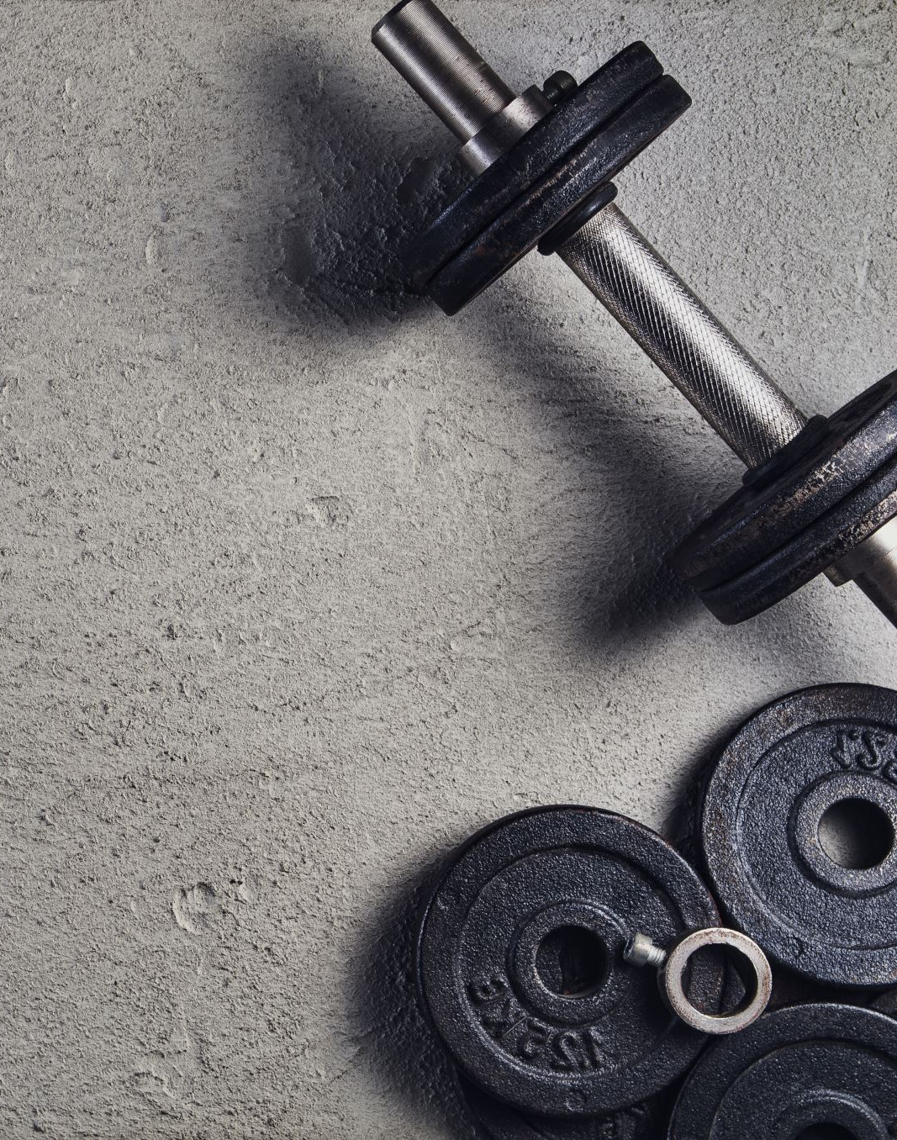
Resident Priorities
Highest Priority:
Walking and jogging track
Adult fitness and wellness programs
Weights and cardio fitness area
Senior health and wellness programs

Slide 5
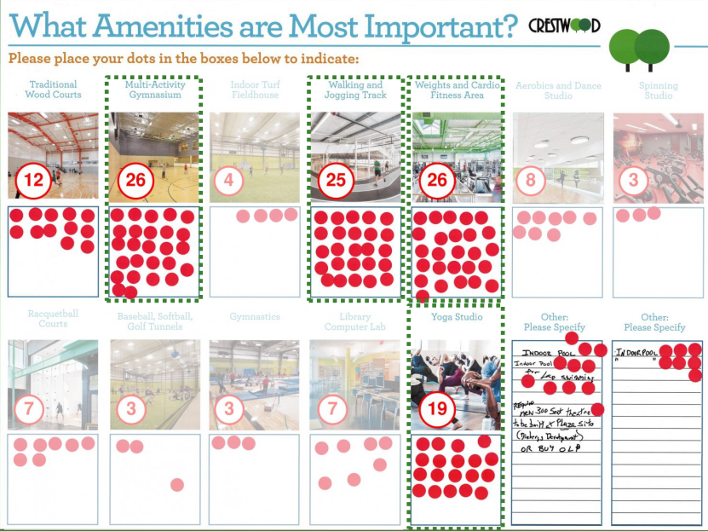
Open House
Multi-Activity Gym (26)
Weights/Cardio Fitness Area (26)
Walking/Jogging Track (25)
Yoga Studio (19)

Slide 6
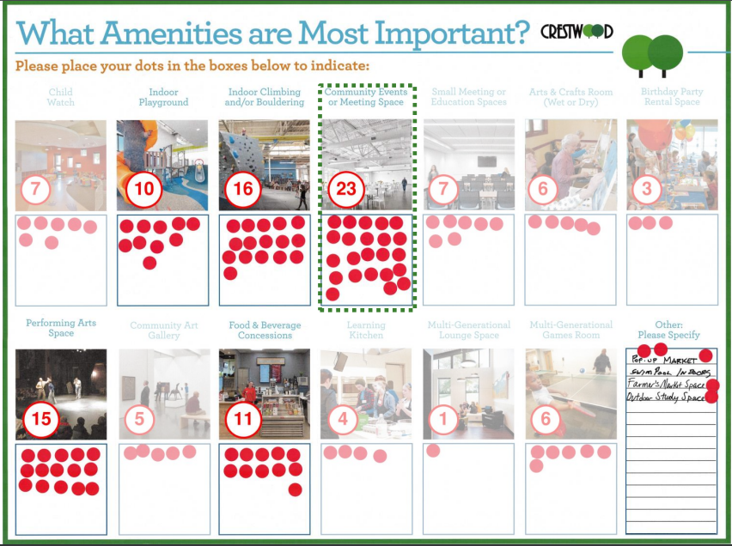
Open House
Community Event/Meeting Space (23)
Indoor Climbing/Bouldering (16)
Performing Arts Space (15)

Slide 7
To meet the needs of the community, the Community Center needs to be addressed
Staff began evaluating options: Renovate and Expand the existing Community Center, or pursue New Construction

Slide 8

Reno/Expansion vs New Construction
New construction is more costly, but you can build exactly what you want, where you want.
Reno/expansion will make use of existing HVAC… including some of the existing HVAC problems.
Reno/expansion will have unforeseen circumstances that will drive up cost (lead paint/asbestos, unseen deterioration over the years, electrical system issues, code compliance, etc…)

Slide 9

Reno/Expansion vs New Construction
Reno/expansion will require compromises on design and features
Reno/expansion will disrupt current operations for 12-20 months while construction is under way
Reno/expansion requires using the existing footprint which could impact natural areas of park
Many aspects of the renovated/expanded building will still be very old after the project is complete

Slide 10
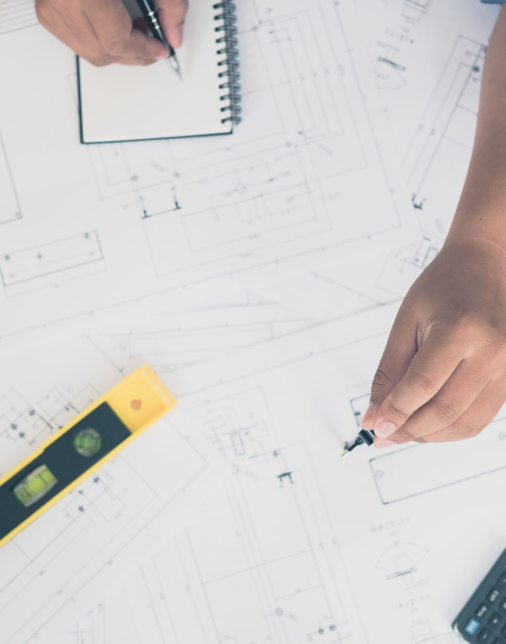
Reno/Expansion vs New Construction
We want to be sure the community will be satisfied with the end result
We must position the Parks and Recreation Department for success for the next several decades.
As a result of extensive review, staff recommended new construction.

Slide 11
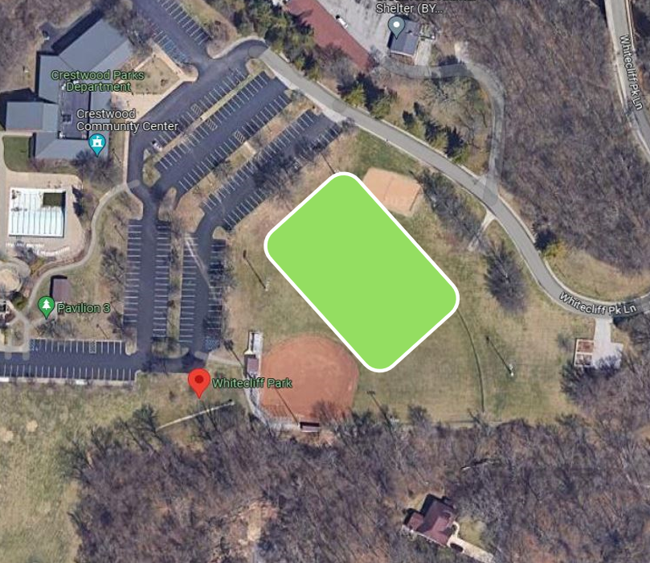
New Construction
Board approved the Whitecliff baseball field as the location for the new Community Center
Board also approved a plan to convert the current community center into a pickleball and family games complex
This kicked off an extensive design process, the results of which we share tonight…

Slide 12
New Community Center

Slide 13
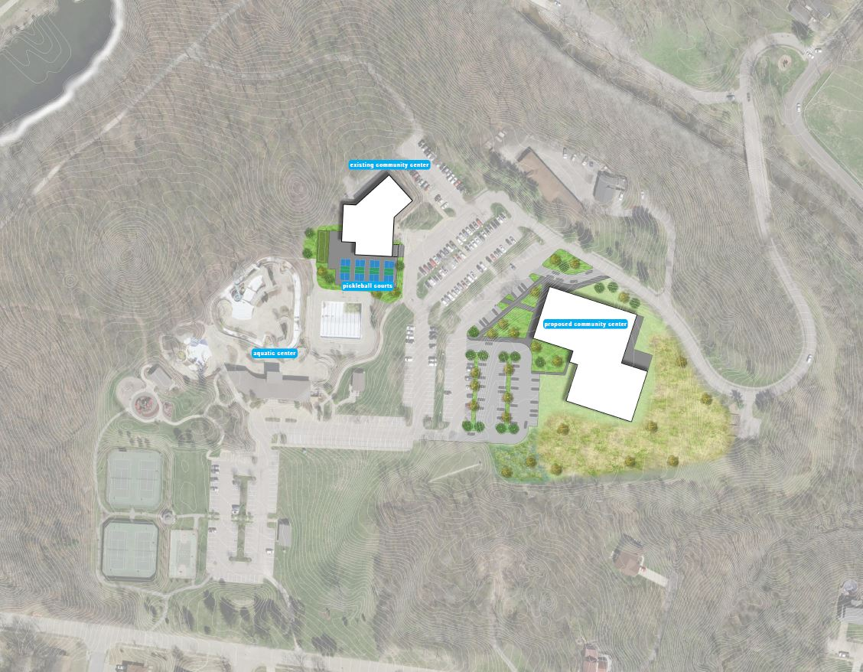
Notes:
Let’s start by reviewing the park as a whole. This slide shows how the facility will be positioned within Whitecliff Park. We love the ballfield location – this means new construction can occur without significant disruption to other areas of the park. It also gives the new facility a place of prominence. This slide also shows the footprint of the converted pickleball and family games complex.

Slide 14
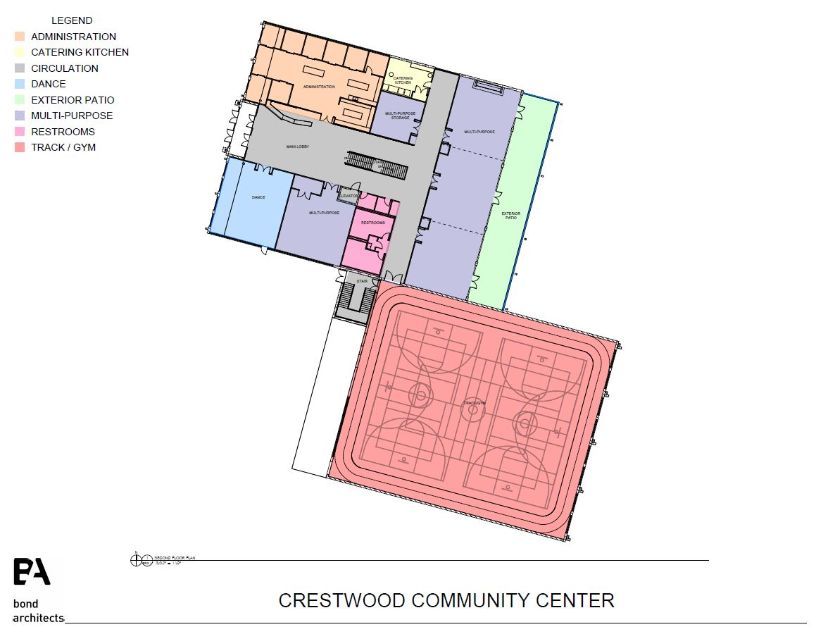

Slide 15
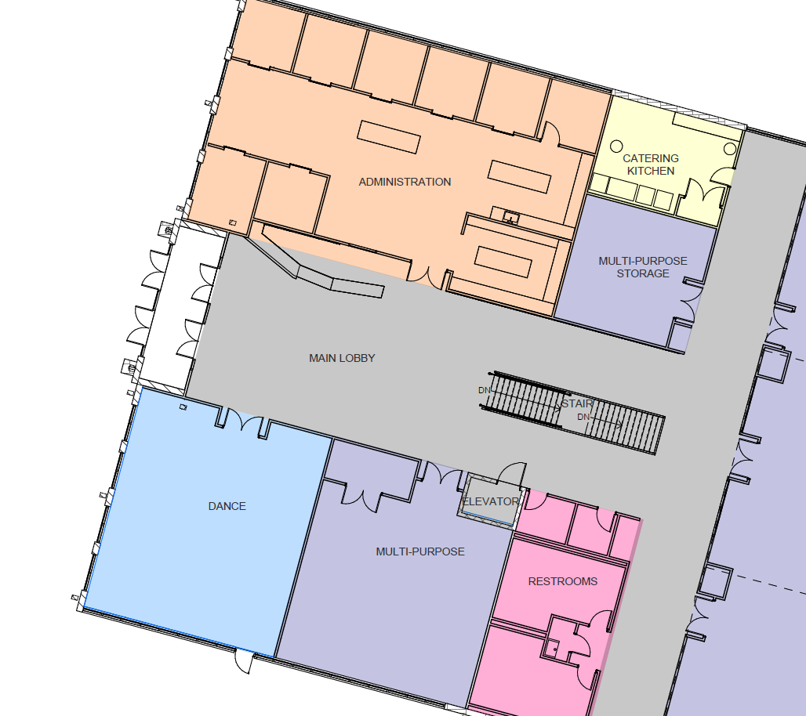

Slide 16
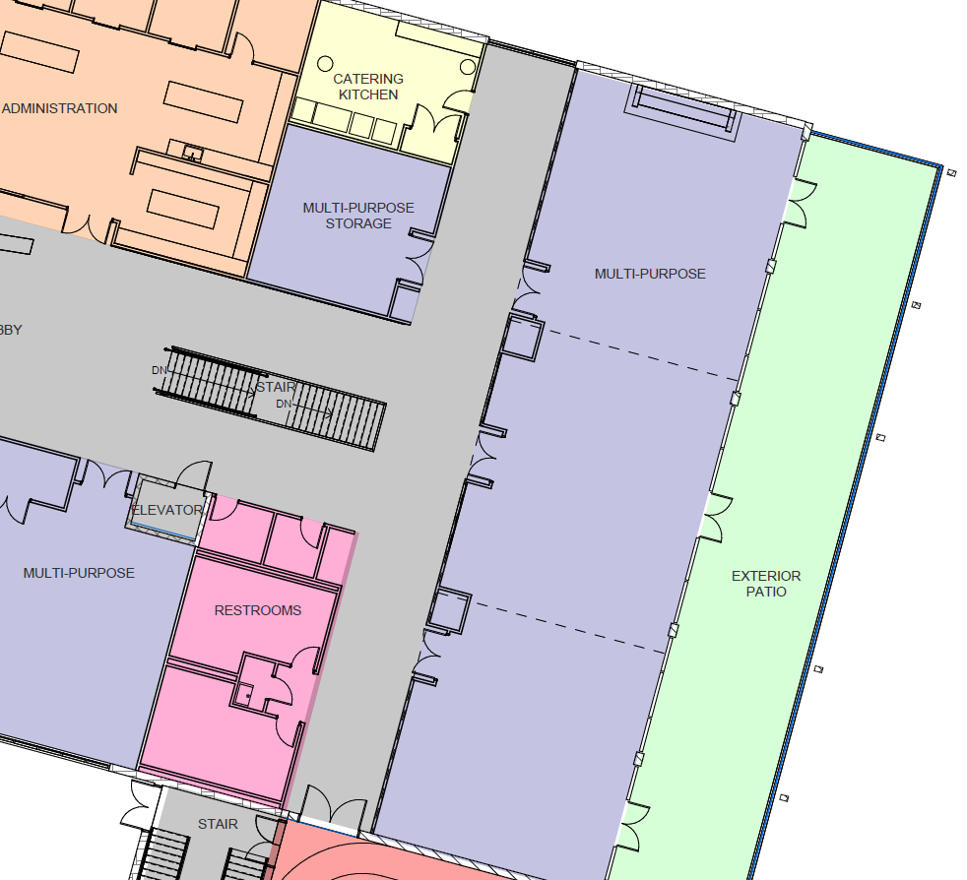

Slide 17
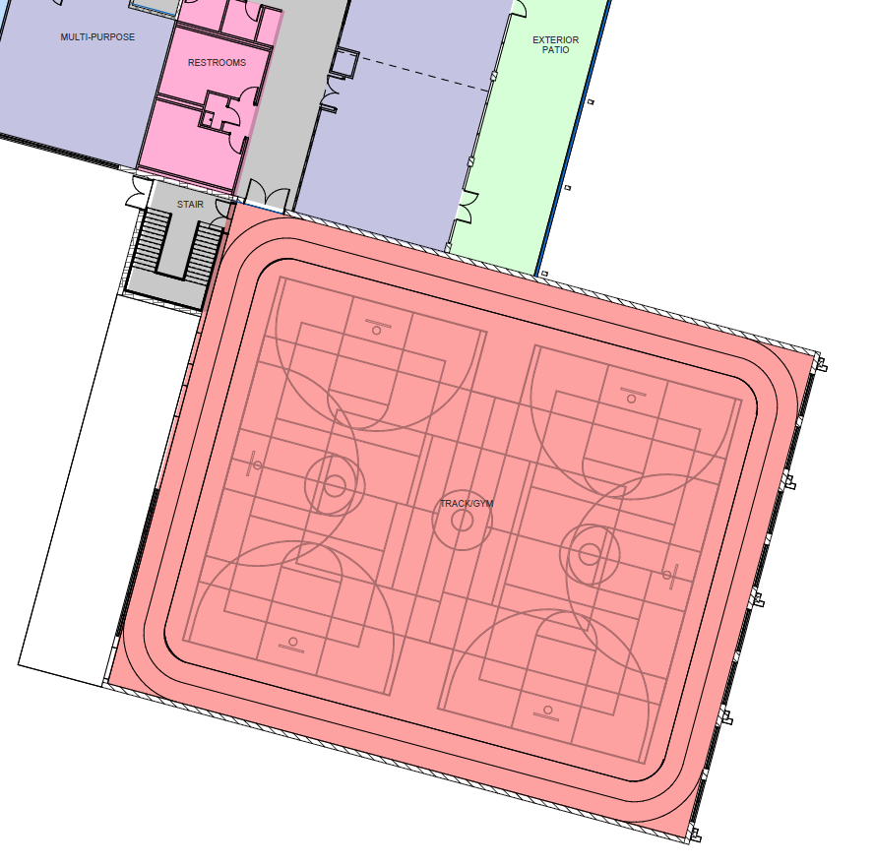

Slide 18
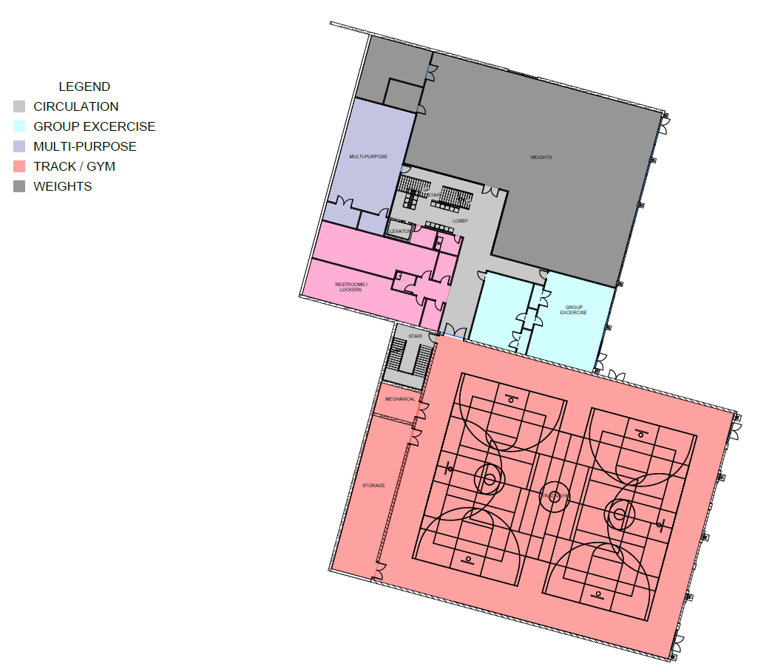

Slide 19
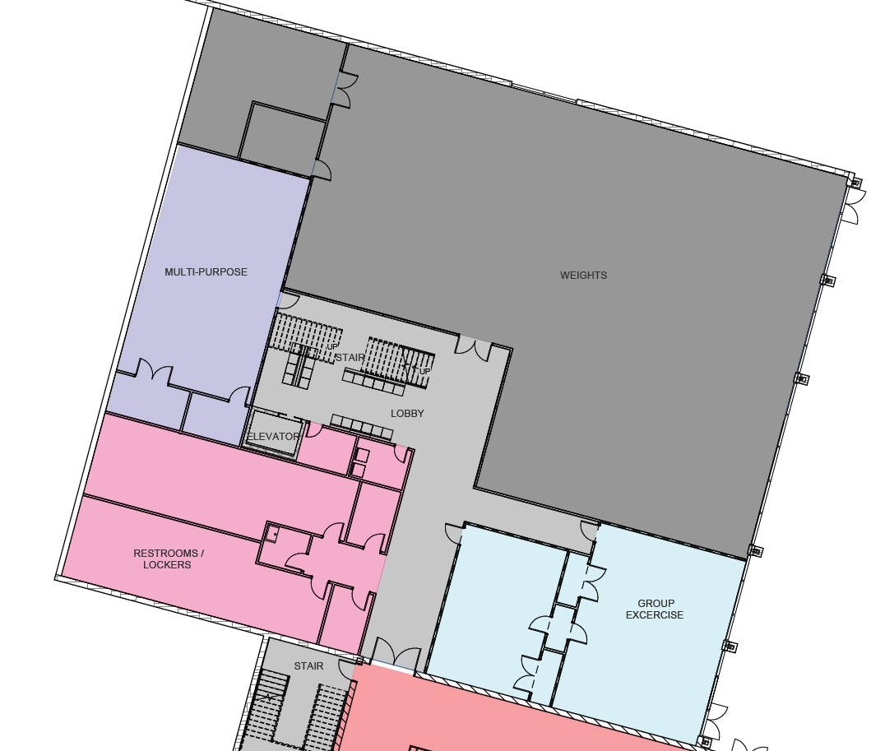

Slide 20
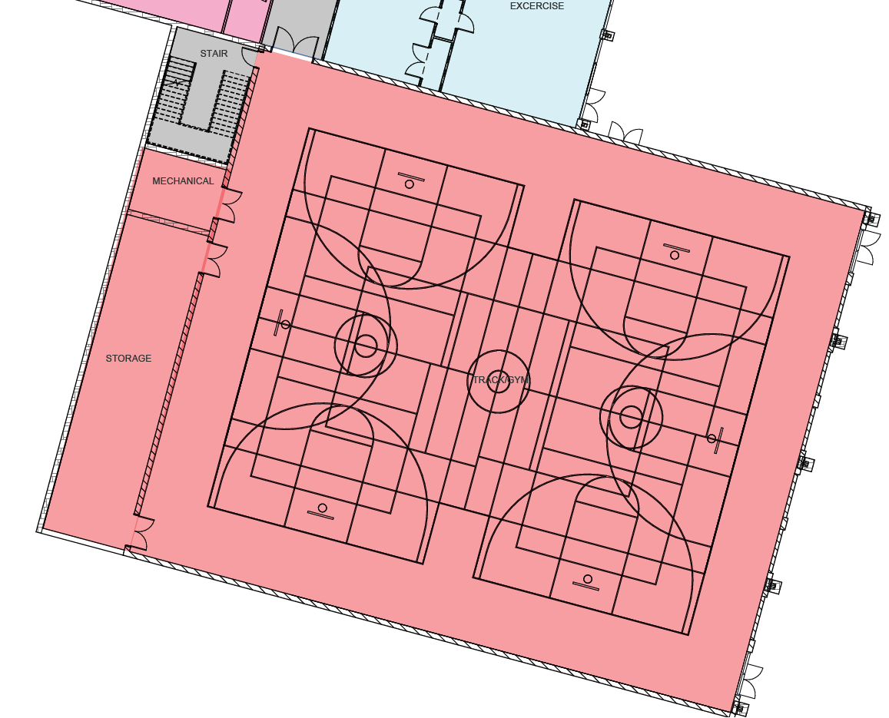

Slide 21
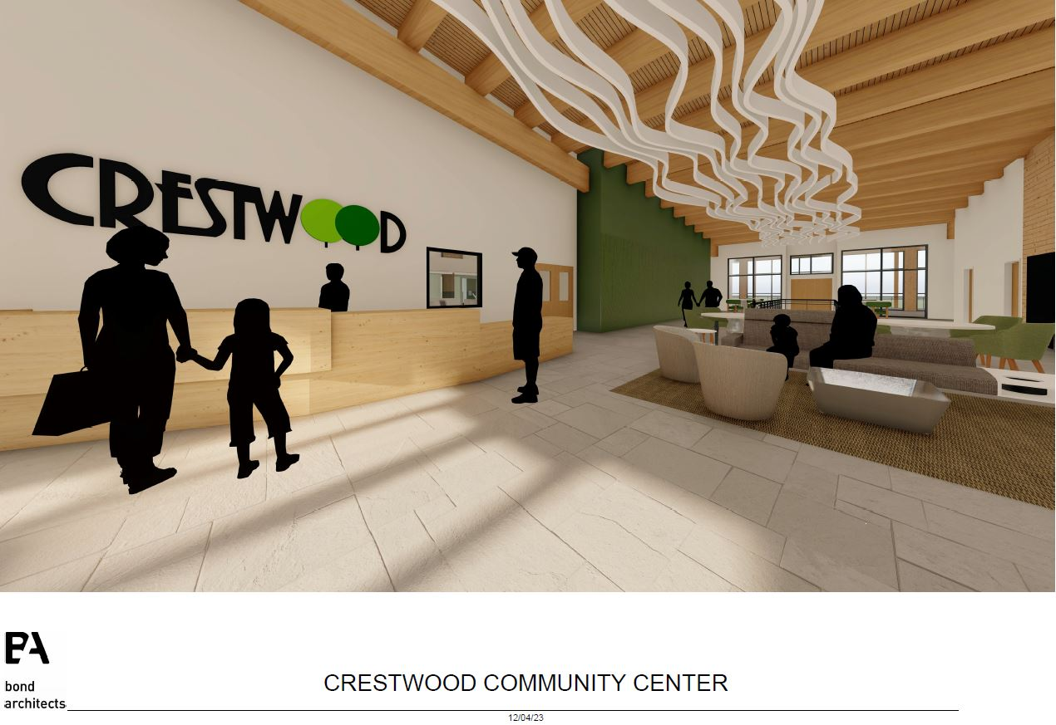

Slide 22
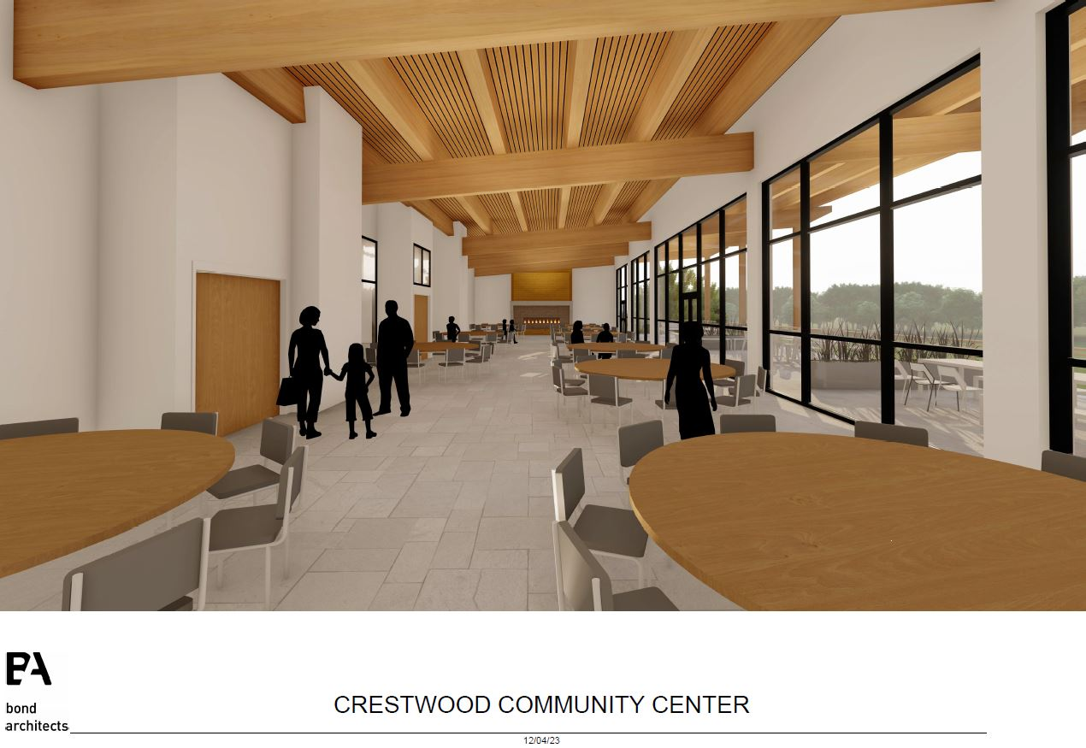

Slide 23
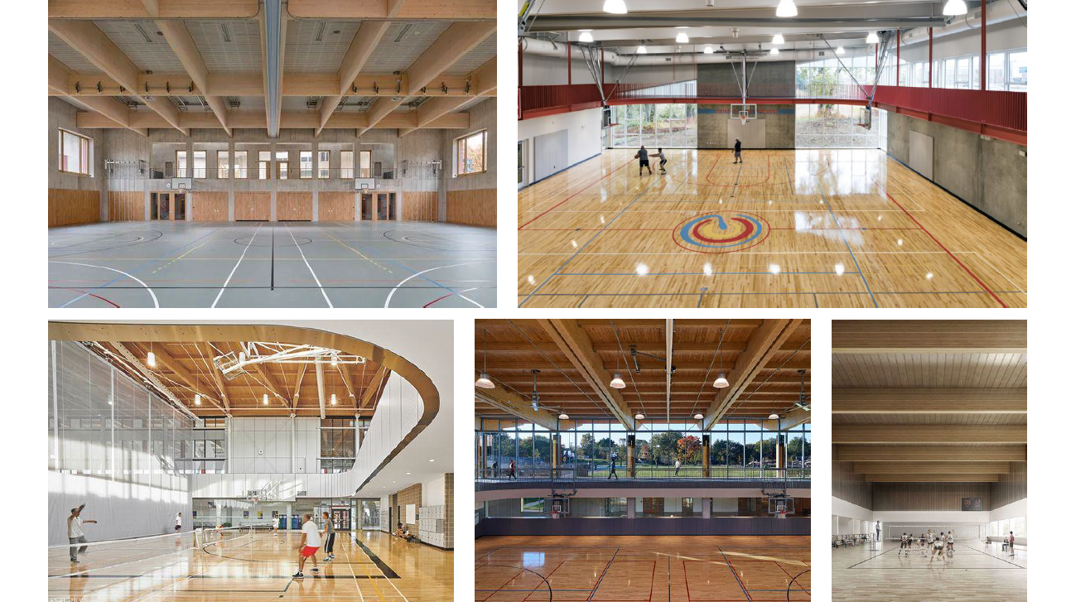

Slide 24
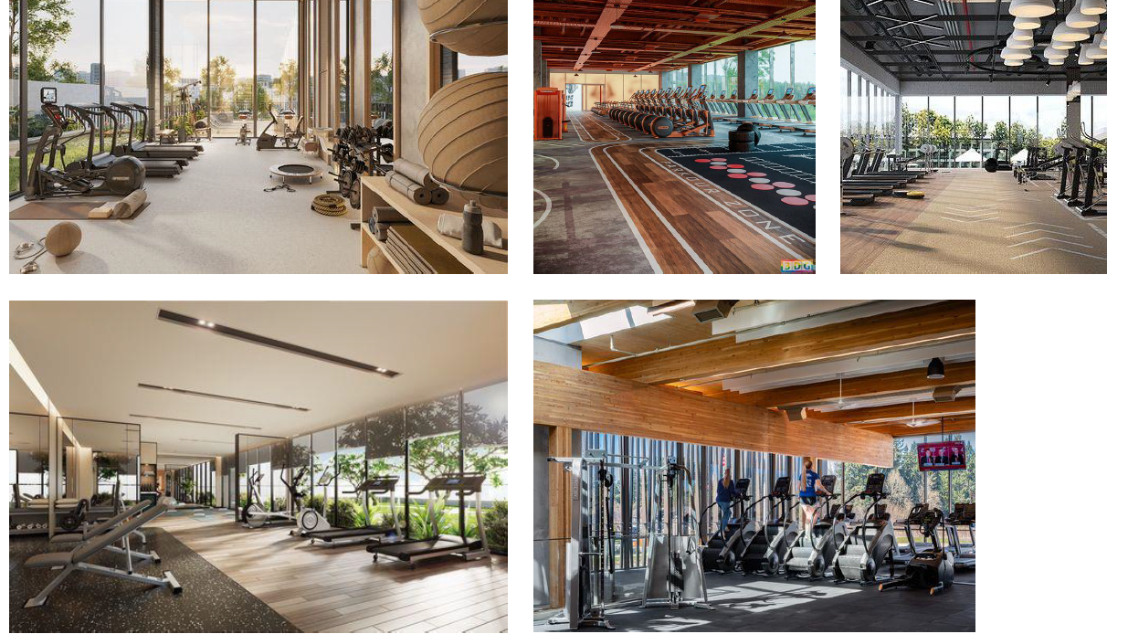

Slide 25
Conversion of Existing Community Center

Slide 26
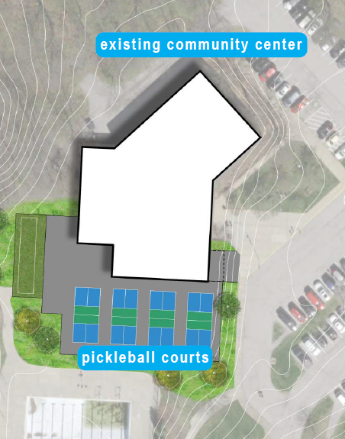
Existing Community Center
Partial demolition of the facility
Gymnasium to remain
  Floor recently replaced, new divider curtain
Locker rooms to remain
  Remodeled a few years ago
Storefront windows will create a new exterior wall separating the lobby from the pickleball court
Gathering space with food and beverage service

Slide 27
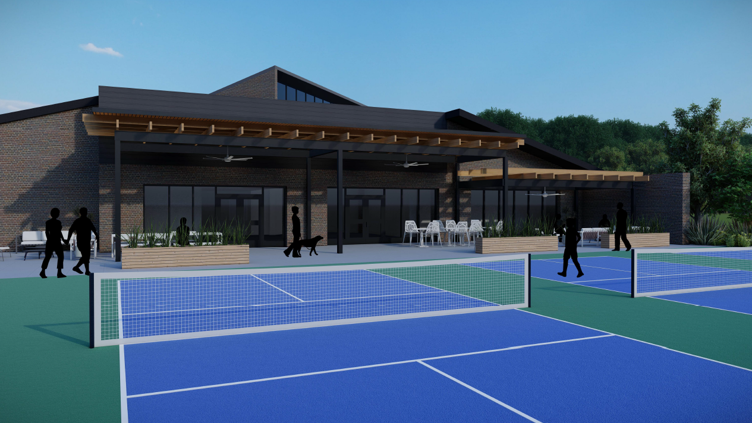

Slide 28
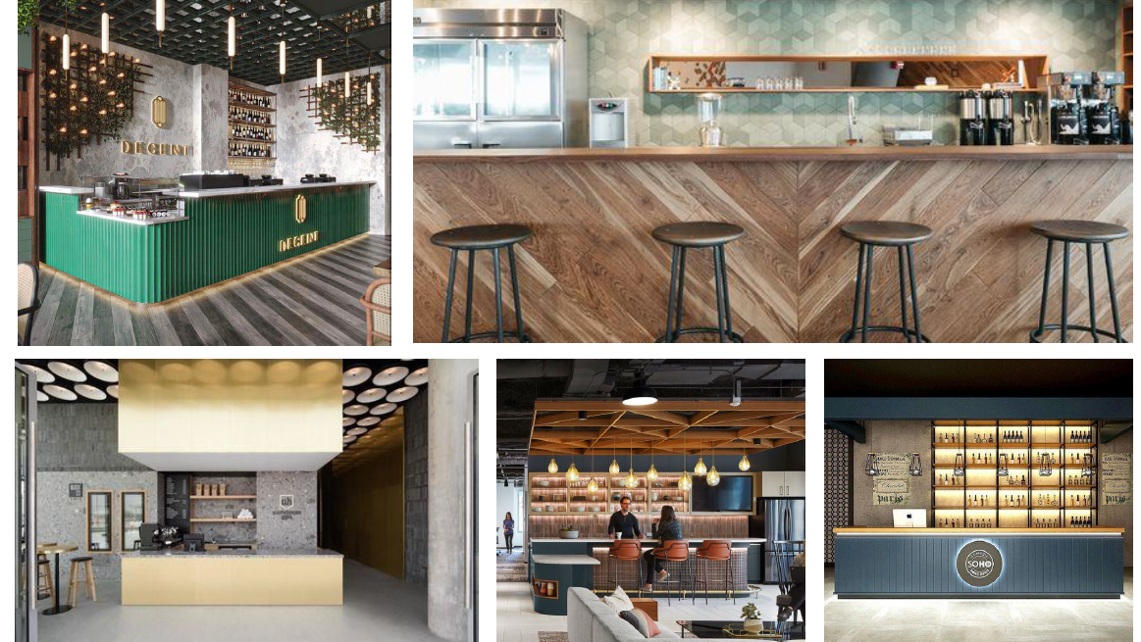

Slide 29
Cost Estimate
Item | Cost
Construction Contracts
New Community Center | $22,552,061
Pickleball/Family Games Complex | $2,570,807
Subtotal | $25,122,868
Special Construction Items: Permits, insurance, utility connection fees | $199,500
Furniture and Fixtures: Furniture, fitness equipment, landscaping | $1,307,395
Professional Services: Architect, construction management, surveys | $3,201,185
Technology: Phones, computers, televisions, A/V, security | $150,000
Financing: Bond counsel, issuance costs | $145,050
Misc. Costs: Bid document advertisement, moving expenses | $62,500
Owner contingency: 5% soft cost contingency | $253,282
Total Project Budget | $30,441,780

Slide 30

Funding Options (High Level)
Surveys indicated there is willingness from residents to fund this project.
Level of support is noteworthy given that people were asked this without any details about the new community center.
Staff believes support increases once residents are engaged in the project.

Slide 31
General Obligation Bond
Requires 4/7 voter approval (57.14%)
Supported by an ad valorem tax on real property within city limits
Lowest interest rate for municipal borrowing
Paid off over 20 years
Crestwood currently has no debt
State law limits debt capacity to 10% of assess value for “general improvements”
  Roughly $40 million based on most recent valuation
$30.91MM Par Value Bond
Home Value | Monthly Cost
$200,000 | $15.20
$250,000 | $19.00
$300,000 | $22.80
$350,000 | $26.60

Slide 32
Other Projects?
Park Master Plan
  Crestwood Park, Replace playground and surfacing, swings: $448,000
  Whitecliff Park, Add walking trail loop: $600,000
  Sanders Park, Replace playground and surfacing: $448,000
  Spellman Park, Replace playground and surfacing: $336,000
  Whitecliff Park, Add pedestrian trail bridge to Lodgepole/Sheryl Ann: $1,300,000
  Sappington Park, Address leaking pond: $126,000
  Crestwood Park, Reconfigure parking lot: $540,000
  Whitecliff Park, Add nature play area: $220,000
  Ferndale Park, Add second ADA access path: $360,000

Slide 33
Four Proposed Project Packages
Package #1: $33.63M
Crestwood Park playground
Whitecliff trail loop
Sanders Park playground
Spellman Park playground
Sappington Park pond
Crestwood parking lot reconfiguration
Whitecliff nature play area
Package #2: $34.04M
Crestwood Park playground
Whitecliff trail loop
Sanders Park playground
Spellman Park playground
Whitecliff Park pedestrian trail bridge
Package #3: $33.70M
Crestwood Park playground
Whitecliff Park trail loop
Sanders Park playground
Whitecliff Park pedestrian trail bridge
Package #4: $32.74M
Crestwood Park playground
Whitecliff trail loop
Sanders Park playground
Spellman Park playground

Slide 34
Next Steps and Timeline
At January BOA meeting, staff will bring an ordinance placing a bond issue on the April 2024 municipal election ballot
Staff will begin public information effort about the ballot measure
If approved by voters in April, Bond Architects will begin work on construction plans
Goal is to go to bid Q12025

