Slide 1
Community Center
Master Plan Next Steps

Slide 2
Process Review
September 2021 – City holds meeting at Community Center to discuss condition of the facility.
  Staff memo noted the facility was built in 1978 (45 years old).
  Many aspects of the building are original and are 20-30 years beyond their useful life. Some updates have been performed.
    HVAC – all but one unit have been replaced recently. New HVAC units “work” but have caused problems.
    Lighting needs to be replaced throughout the building.
  Exterior elements of the building are well into their useful lives:
    Brick exterior, appears to be good condition, is 45 years into a 50-100 year lifespan
    Roofing was replaced in 2017, and is 6 years into a 25 year lifespan
    Windows and doors are original and need to be replaced
  The finishes and layout of the building are outdated and not serving the community well.

Slide 3
Process Review
Board of Aldermen requested examination of options for the Community Center as part of the Parks Master Planning process
Staff and Consultants have conducted a needs analysis, informed by town hall sessions with the public, a citizen survey, meetings with city staff, and applying their professional expertise

Slide 4
Staff Recommendations Seeking Approval Tonight
Pursue a new community center?
If so, renovate/expand or new construction?
If new construction, where should it be located?
If new construction, what to do with old community center?
Business case for new community center
How would this be funded?
Next steps and projected timeline

Slide 5
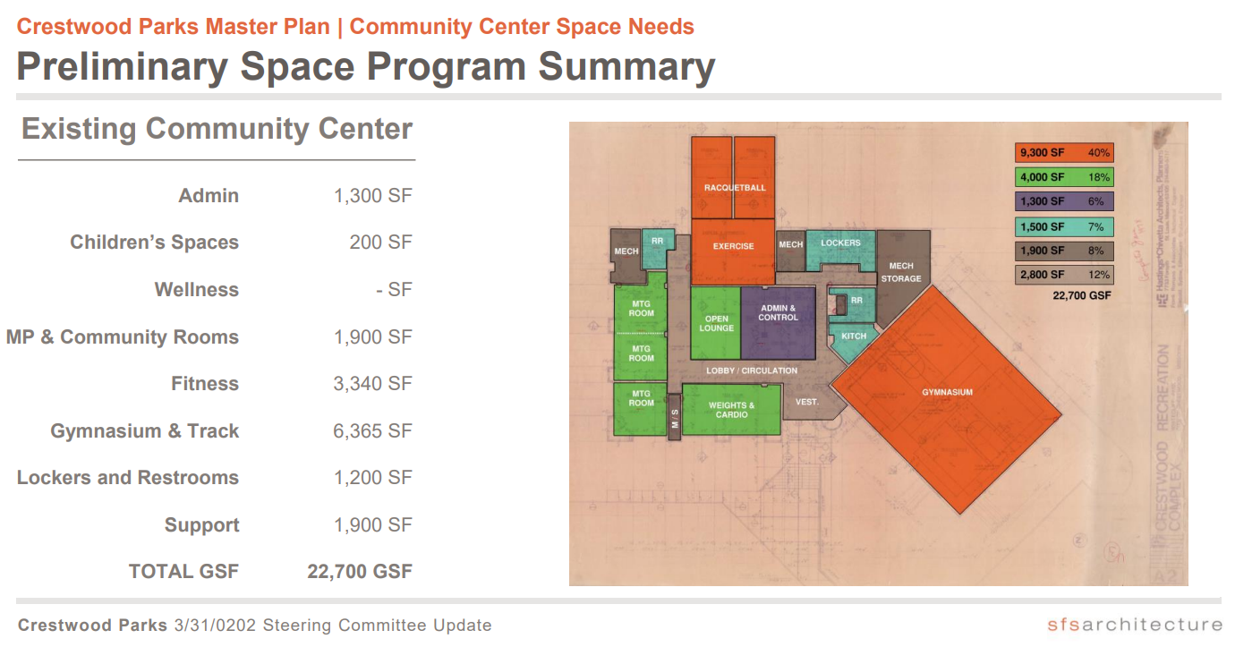

Slide 6
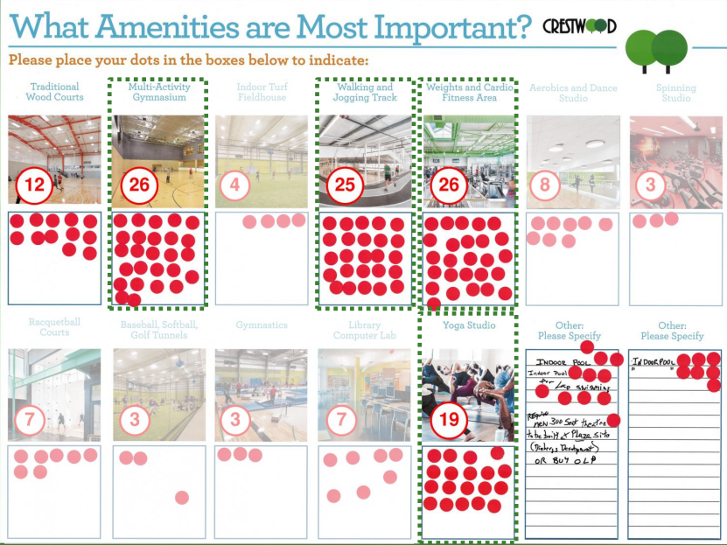
Open House
Multi-Activity Gym (26)
Weights/Cardio Fitness Area (26)
Walking/Jogging Track (25)
Yoga Studio (19)

Slide 7
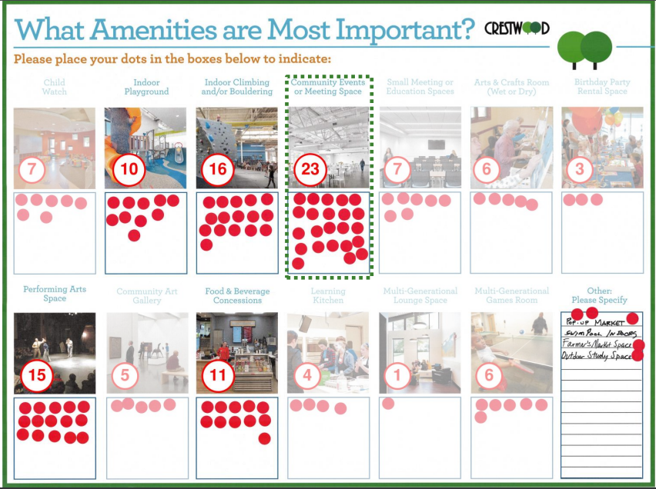
Open House
Community Event/Meeting Space (23)
Indoor Climbing/Bouldering (16)
Performing Arts Space (15)

Slide 8
Citizen Survey
Parks and Rec survey conducted spring/summer 2022
458 households responded
(goal was 300)
Statistically valid survey, 95% CONFIDENCE precision rate of +/- 4.6%
only going to review responses related to Community Center

Slide 9
Citizen Survey
50% of respondents indicated they have used Crestwood Community Center.
Top facility priorities:
1) Whitecliff Park
2) Crestwood Park
3) Community Center
95% of respondents “strongly agreed” or “agreed” that updating existing park amenities should be a priority.
85% of respondents “strongly agreed” or “agreed” that rehabilitating the current Community Center should be a priority.
Of those respondents who use the Community Center, 90% are “Very Satisfied” or “Satisfied”

Slide 10
97% of respondents indicated this is very/somewhat important

Slide 11
87% of respondents used park facilities provided by City of Crestwood

Slide 12
62% of respondents rely on Crestwood the most

Slide 13
Citizen Survey
Priority Investment Rating (PIR) equally weights 1) the community’s importance of particular park-related features and 2) how many households have unmet needs for that feature.
A PIR over 100 or higher is considered “High Priority”
A PIR from 50-99 is considered “Medium Priority”
The following slides will only review the High and Medium PIR items related to the community center.

Slide 14
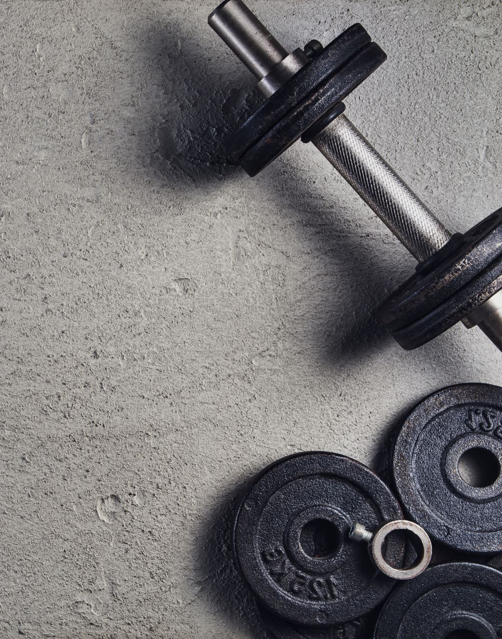
Resident Priorities
High Priority:
PIR: 200 Walking and jogging track
PIR: 200 Adult fitness and wellness programs
(Note: these two are the highest PIR items in the entire survey)
PIR: 137 Weights and cardio fitness area
PIR: 108 Senior health and wellness programs

Slide 15
Resident Priorities
Medium Priority:
PIR: 97 Yoga studio
PIR: 84 Community events or meeting space
PIR: 79 Senior educational programs
PIR: 77 Concessions
PIR: 77 Indoor playground
PIR: 66 Child care
PIR: 66 Aerobics/dance studio
PIR: 65 STEAM/tech classes

Slide 16
Resident Priorities
Medium Priority (continued)
PIR: 65 Multi-activity gymnasium
PIR: 60 Learning kitchen
PIR: 60 Birthday party rental space
PIR: 59 Arts/crafts room
PIR: 58 Spinning studio
PIR: 51 Community art gallery

Slide 17
Conclusion
To address the outdated facility, and meet the needs of the community, the Community Center needs to be addressed
Staff began evaluating options: Renovate and Expand the existing Community Center, or pursue New Construction

Slide 18
New Construction

Slide 19
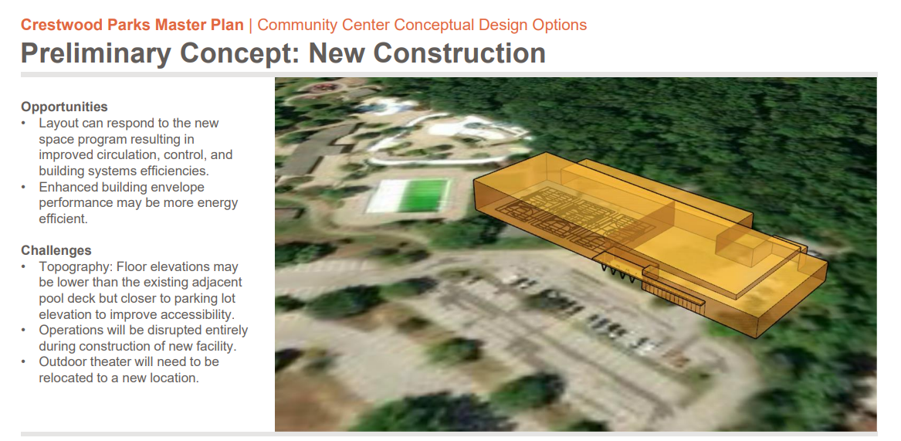

Slide 20
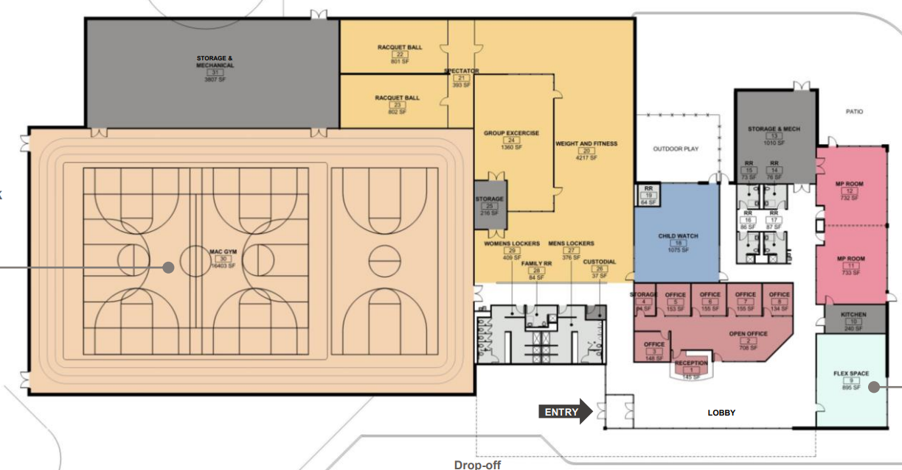

Slide 21
New Construction Space Program
 | Existing Comm Ctr | New Construction
Space Type | Sq. Ft | Sq. Ft.
Admin | 1,300 | 1,692
Children’s | 200 | 1,075
Flex | 0 | 895
MP & Community | 1,900 | 1,465
Fitness | 3,340 | 7,573
Gym + Track | 6,365 | 16,403
Lockers/Restroom | 1,200 | 1,191
Support | 1,900 | 5,310
TOTAL | 22,700 | 41,400

Slide 22
Renovation/Expansion

Slide 23
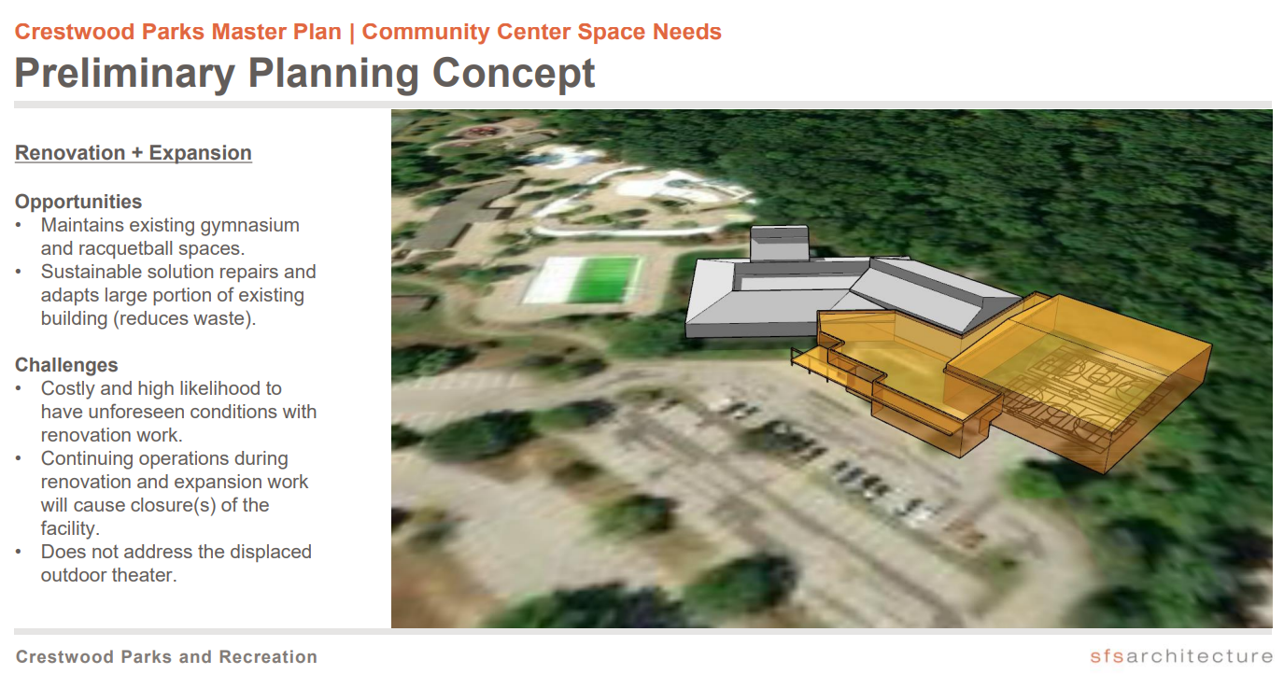

Slide 24
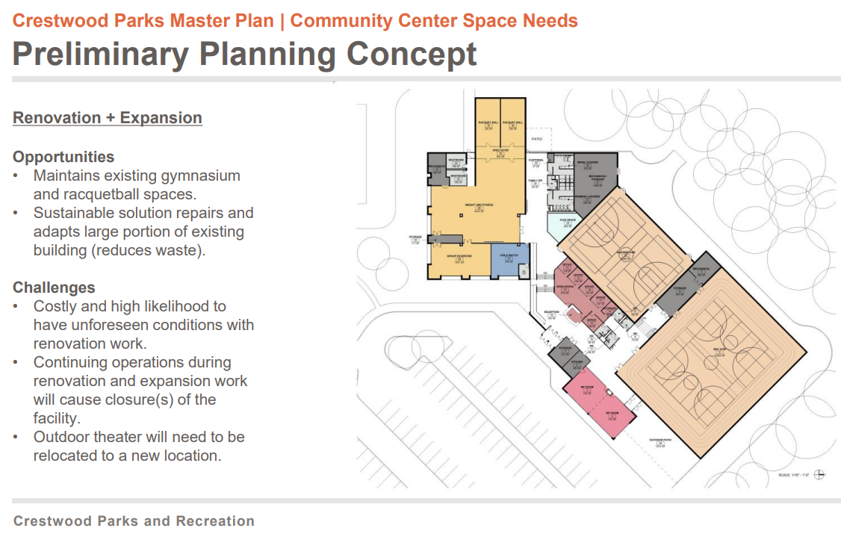

Slide 25
Reno/Expansion Space Program
 | Existing Comm Ctr | Reno/Expansion
Space Type | Sq. Ft | Sq. Ft.
Admin | 1,300 | 1,639
Children’s | 200 | 839
Flex | 0 | 463
MP & Community | 1,900 | 2,051
Fitness | 3,340 | 7,601
Gym + Track | 6,365 | 18,477
Lockers/Restroom | 1,200 | 1,606
Support | 1,900 | 3,130
TOTAL | 22,700 | 44,300

Slide 26
Space Program Comparison
 | Existing Comm Ctr | Reno/Expansion | New Const.
Space Type | Sq. Ft | Sq. Ft. | Sq. Ft.
Admin | 1,300 | 1,639 | 1,692
Children’s | 200 | 839 | 1,075
Flex | 0 | 463 | 895
MP & Community | 1,900 | 2,051 | 1,465
Fitness | 3,340 | 7,601 | 7,573
Gym + Track | 6,365 | 18,477 | 16,403
Lockers/Restroom | 1,200 | 1,606 | 1,191
Support | 1,900 | 3,130 | 5,310
TOTAL | 22,700 | 44,300 | 41,400

Slide 27
Estimated Cost Comparison
 | New Facility | Reno+Expansion
Construction | $22,615,183 | $17,476,939
Soft Costs | $4,938,480 | $3,897,070
Total | $27,553,662 | $21,374,009

Slide 28

Reno/Expansion vs New Construction
New construction is more costly, but you can build exactly what you want, where you want.
Reno/expansion will make use of existing HVAC… including some of the existing HVAC problems.
Reno/expansion will have unforeseen circumstances that will drive up cost (lead paint/asbestos, unseen deterioration over the years, electrical system issues, code compliance, etc…)

Slide 29
Reno/Expansion vs New Construction
Reno/expansion will require compromises on design and features
Reno/expansion will disrupt current operations for 12-20 months while construction is under way
Reno/expansion requires using the existing footprint
Many aspects of the renovated/expanded building will still be very old after the project is complete

Slide 30
Reno/Expansion vs New Construction
We want to be as confident as possible that the community will be satisfied with the end result,
We are positioning our Parks and Recreation Department for success for the next several decades.
After discussing with consultant team, and internal discussions, staff recommends new construction.

Slide 31
New Construction Location

Slide 32
New Construction Location
Staff evaluated locations for a new construction community center:
  On the “sledding hill”
  On the existing footprint
  On the ballfield

Slide 33
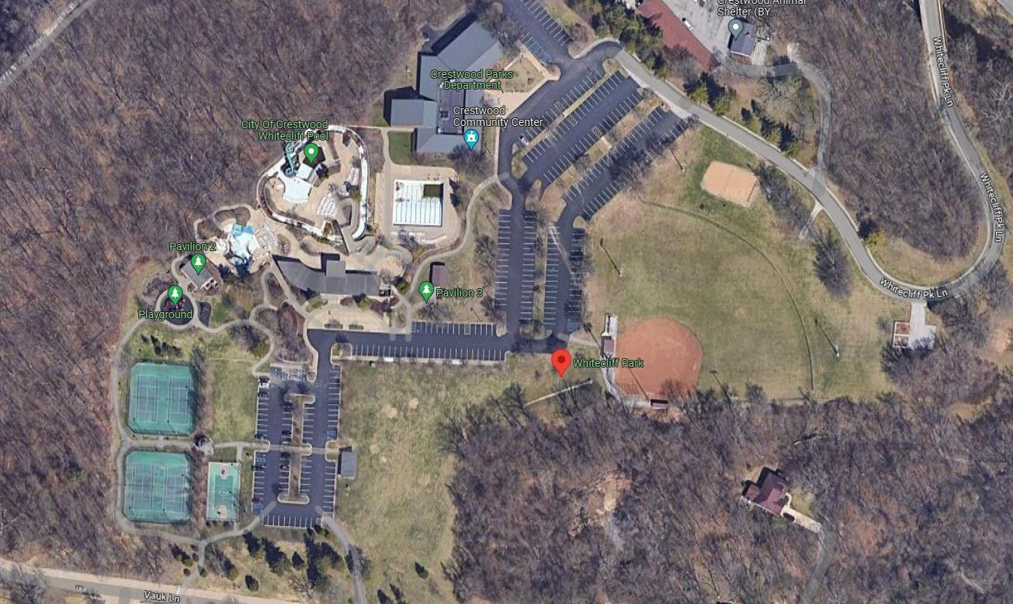

Slide 34
Hill Location
Hill location quickly eliminated
Too close to adjacent residences
Not able to have sufficient parking
Leaves much of the existing parking (between current Community Center and ballfield) open with no real purpose
Hill identified in Master Plan for other uses

Slide 36
Existing Location
Building on the existing footprint is a viable option
However this would disrupt Parks and Rec operations for over a year while construction was under way
We’d have to find a place to house full-time staff
We would have to let go all part-time employees
  When we re-open these employees would have moved on to new employers. Brand new staff learning a new job and a new facility at the same time.
Revenue loss as program offerings impacted during construction. No memberships.

Slide 38
Ballfield Location
Staff recommends this location
The current ballfield is underutilized
Robust Baseball/softball programs require multiple fields
This is not a major revenue source and requires a fair amount of maintenance
Building here would allow us to continue operations at the current Community Center during construction, with less disruption to the rest of the park
A new community center here would use the existing parking lots
A new community center at this location could be positioned to dramatically enhance the “park entrance” experience as residents drive up the hill and see the new facility

Slide 39
Old Community Center Uses

Slide 40

What to do with current community center?
We could demolish the facility and return the area to green space – this is the lowest cost option.
Alternatively, staff developed the idea of partially demolishing the facility, retaining the gymnasium, a small administrative support area, the restrooms and renovated locker rooms, and renovating this modified facility into a pickleball and event center.

Slide 41
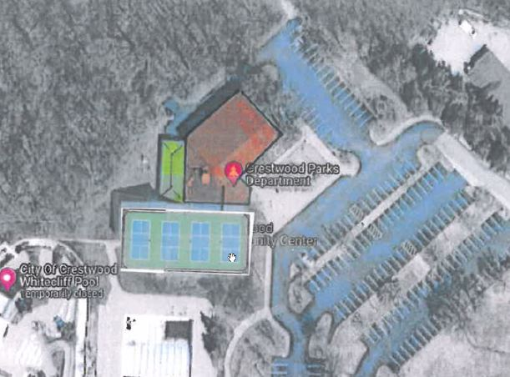

Slide 42
Old Community Center Pickleball Complex
Multiple indoor pickleball courts within the existing gymnasium
Adjacent outdoor pickleball court area with family games like shuffleboard and bocce ball
This would satisfy some of the other high priority resident survey items, create additional community value, generate revenue and heighten interest in the overall project
Aside from pickleball, the old single gymnasium could still be rented out for events like trivia nights.
A cost estimate for this project is $2 million.

Slide 43

Vision Board Examples

Slide 44
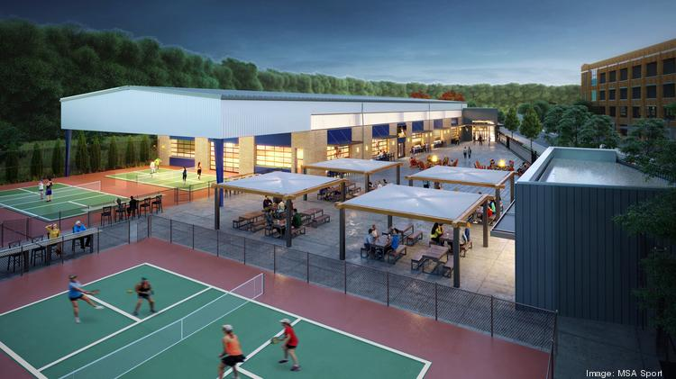

Slide 45
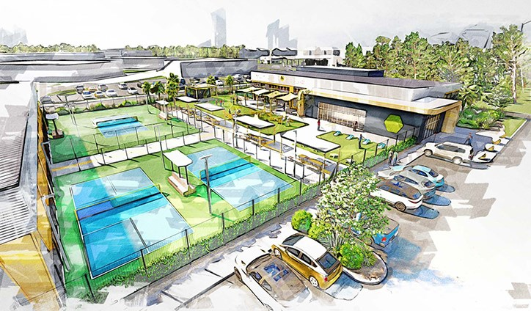

Slide 46
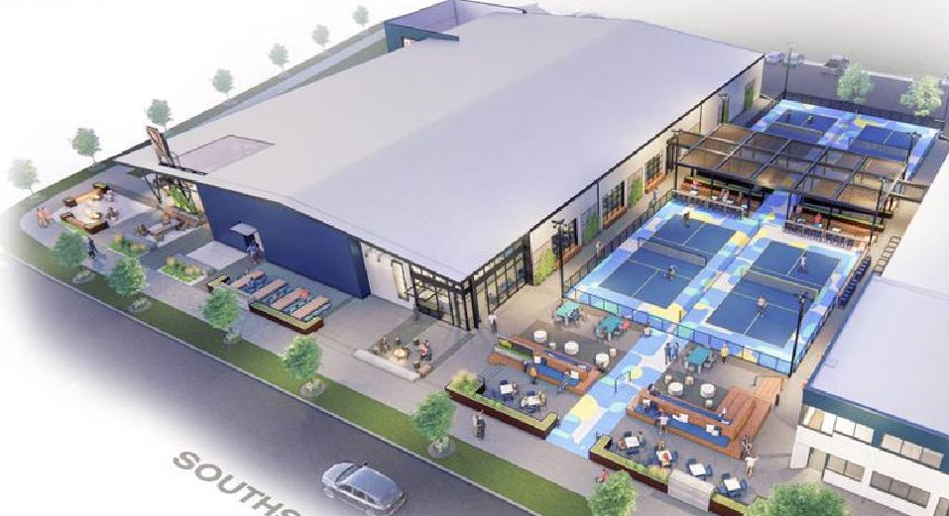

Slide 47
Business Case for New Community Center

Slide 48

Community Center Business Operations
The following slides compare the business operations of our current community center against a hypothetical new community center
Our current facility’s cost recovery rate is well below average, at 55%
An outdated, unattractive facility makes it difficult to sell memberships. Just to get the members we have we must keep membership rates low
Because the facility is small, we are limited in the quantity and variety of programs we can offer
A new facility would sell more memberships, and we could demand a higher price

Slide 49
Regional Cost Recovery Research
Webster Groves: 89%
Sunset Hills: 80-90%
Clayton: 94% (pre-COVID), 77% (post-COVID)
Richmond Heights: 90-100%
Ballwin: 90-100%
Des Peres: 80%
Crestwood: 58%

Slide 50
Current Facility Costs
New Facility Costs
Category | Cost
Staffing:
Director | $100,000
Recreation Manager | $65,000
3 Recreation Specialists | $155,000
Custodian | $40,000
PT Staffing | $84,500
Operational Costs: (Utilities, Maintenance, Programming) | $380,000
Total Costs | $824,500
Category | Cost
Staffing:
Director | $100,000
Recreation Manager | $65,000
Facility Manager | $65,000
Recreation Supervisor | $60,000
2 Rec Specialists | $100,000
2 Custodians | $80,000
PT Staffing | $285,000
Operational Costs: | $425,000
Total Costs: | $1,180,000

Slide 51
Current Facility Revenues
New Facility Revenues
Category | Revenue
Membership | $122,568
Programmatic Revenue | $285,000
Silver Sneakers/Active Renew Program | $15,000
Rentals | $35,000
Total Revenue | $457,568
Category | Revenue
Membership | $397,991
Programmatic Revenue | $485,000
Silver Sneakers/Active Renew Program | $21,000
Rentals | $77,000
Total Revenue | $980,991

Slide 52
Comparison of Operating Costs and Revenues
 | Revenues | Expenditures | Difference
Current Facility | $457,568 | $824,500 | ($366,932)
New Facility | $998,000 | $1,180,000 | ($182,000)
While the new facility still operates at a deficit, the overall cost recovery is now 84%,
which in line with regional norms. Our goal would be to achieve a greater cost recovery
but for the purposes of this pro forma we wanted to be conservative.

Slide 53
New Program Revenues and Memberships
Main reason for improved cost recovery is memberships and new program revenue, adding $275k and $200k in increased revenues, respectively.

Slide 54
New Program Revenues and Memberships
Main reason for improved cost recovery is memberships and new program revenue, adding $275k and $200k in increased revenues, respectively.
Some detail on those projections:
  We project to sell a greater number of memberships, at a higher fee
  The membership fees are based on a study of regional community center memberships and are in line with area norms
  The membership sales numbers are based on our market reach (~70,000 in our 15-minute drive-time area) and assume we achieve an industry standard membership rate (5%).

Slide 55
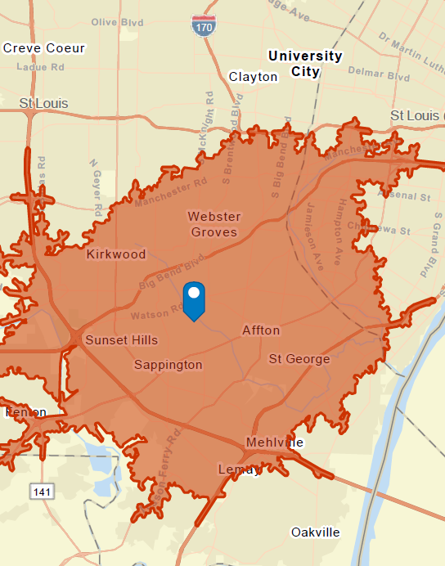
Market Area
(15 Min Drive)
We looked at our market area, excluding Kirkwood, Webster, and Sunset Hills
We’re left with an estimated 70,000 target customers
Membership revenues assume we sell passes to 5% of this customer base

Slide 56
Memberships
Membership Type | # | Cost
Resident ID Card | 3,501 | $5
Non-Resident ID Card | 3,053 | $10
Lindbergh ID Card | 40 | $10
Daily Resident Fee | 483 | $3
Daily Non-Resident Fee | 1,285 | $6
Resident Rec Pass | 55 | $115
Family Res Rec Pass | 64 | $175
Non-Resident Rec Pass | 32 | $144
Family Non-Resident Rec Pass | 0 | $256
Lindbergh Res Rec Pass | 24 | $125
Family Lindbergh Rec Pass | 3 | $238
Additional Person Fees -Rec Pass | 4 | $20
Resident All Facility Pass | 73 | $138
Family Resident All Facility Pass | 30 | $330
Non-Resident All Facility Pass | 8 | $248
Family Non-Resident All Facility Pass | 10 | $550
Lindbergh All Facility Pass | 10 | $220
Family Lindbergh All Facility Pass | 21 | $495
Additional Person Fees - All | 22 | $50
We have 19 membership categories
Here are the current number of memberships and rates
In total, we currently generate $122,568 in membership revenue

Slide 57
Memberships
Membership Type | Current | Projected | Increase
Resident ID Card | 3,501 | 4,101 | 600
Non-Resident ID Card | 3,053 | 3,205 | 152
Lindbergh ID Card | 40 | 0 | -40
Daily Resident Fee | 483 | 604 | 121
Daily Non-Resident Fee | 1,285 | 1,606 | 321
Resident Rec Pass | 55 | 150 | 95
Family Res Rec Pass | 64 | 150 | 86
Non-Resident Rec Pass | 32 | 87 | 55
Family Non-Resident Rec Pass | 0 | 84 | 84
Lindbergh Res Rec Pass | 24 | _ | -24
Family Lindbergh Rec Pass | 3 | _ | -3
Additional Person Fees -Rec Pass | 4 | 32 | 28
Resident All Facility Pass | 73 | 150 | 77
Family Resident All Facility Pass | 30 | 150 | 120
Non-Resident All Facility Pass | 8 | 9 | 1
Family Non-Resident All Facility Pass | 10 | 13 | 3
Lindbergh All Facility Pass | 10 | _ | -10
Family Lindbergh All Facility Pass | 21 | _ | -21
Additional Person Fees - All | 22 | 44 | 22
These 40 go into Non-Residents
We would maintain most membership categories except Lindbergh SD
Based on our market reach we believe we can sell more memberships
This slide shows the estimated increase in memberships
These 24 go into Non-Residents
These 3 go into Non-Residents
These 10 go into Non-Residents
These 21 go into Non-Residents

Slide 58
Memberships
Membership Type | Current | Projected | Increase
Resident ID Card | 3,501 | 4,101 | 600
Non-Resident ID Card | 3,053 | 3,205 | 152
Lindbergh ID Card | 40 | 0 | -40
Daily Resident Fee | 483 | 604 | 121
Daily Non-Resident Fee | 1,285 | 1,606 | 321
Resident Rec Pass | 55 | 150 | 95
Family Res Rec Pass | 64 | 150 | 86
Non-Resident Rec Pass | 32 | 87 | 87
Family Non-Resident Rec Pass | 0 | 84 | 84
Lindbergh Res Rec Pass | 24 | _ | -24
Family Lindbergh Rec Pass | 3 | _ | -3
Additional Person Fees -Rec Pass | 4 | 32 | 28
Resident All Facility Pass | 73 | 150 | 77
Family Resident All Facility Pass | 30 | 150 | 120
Non-Resident All Facility Pass | 8 | 9 | 1
Family Non-Resident All Facility Pass | 10 | 13 | 3
Lindbergh All Facility Pass | 10 | _ | -10
Family Lindbergh All Facility Pass | 21 | _ | -21
Additional Person Fees - All | 22 | 44 | 22
The membership sales in this category increase revenues from $57k to $71k
We would maintain most membership categories except Lindbergh SD
Based on our market reach we believe we can sell more memberships
This slide shows the estimated increase in memberships

Slide 59
Memberships
Membership Type | Current | Projected | Increase
Resident ID Card | 3,501 | 4,101 | 600
Non-Resident ID Card | 3,053 | 3,205 | 152
Lindbergh ID Card | 40 | 0 | -40
Daily Resident Fee | 483 | 604 | 121
Daily Non-Resident Fee | 1,285 | 1,606 | 321
Resident Rec Pass | 55 | 150 | 95
Family Res Rec Pass | 64 | 150 | 86
Non-Resident Rec Pass | 32 | 87 | 87
Family Non-Resident Rec Pass | 0 | 84 | 84
Lindbergh Res Rec Pass | 24 | _ | -24
Family Lindbergh Rec Pass | 3 | _ | -3
Additional Person Fees -Rec Pass | 4 | 32 | 28
Resident All Facility Pass | 73 | 150 | 77
Family Resident All Facility Pass | 30 | 150 | 120
Non-Resident All Facility Pass | 8 | 9 | 1
Family Non-Resident All Facility Pass | 10 | 13 | 3
Lindbergh All Facility Pass | 10 | _ | -10
Family Lindbergh All Facility Pass | 21 | _ | -21
Additional Person Fees - All | 22 | 44 | 22
The membership sales in this category increase revenues from $57k to $71k
We would maintain most membership categories except Lindbergh SD
Based on our market reach we believe we can sell more memberships
This slide shows the estimated increase in memberships
This category increases revenues from $25k to $176k

Slide 60
Memberships
Membership Type | Current | Projected | Increase
Resident ID Card | 3,501 | 4,101 | 600
Non-Resident ID Card | 3,053 | 3,205 | 152
Lindbergh ID Card | 40 | 0 | -40
Daily Resident Fee | 483 | 604 | 121
Daily Non-Resident Fee | 1,285 | 1,606 | 321
Resident Rec Pass | 55 | 150 | 95
Family Res Rec Pass | 64 | 150 | 86
Non-Resident Rec Pass | 32 | 87 | 87
Family Non-Resident Rec Pass | 0 | 84 | 84
Lindbergh Res Rec Pass | 24 | _ | -24
Family Lindbergh Rec Pass | 3 | _ | -3
Additional Person Fees -Rec Pass | 4 | 32 | 28
Resident All Facility Pass | 73 | 150 | 77
Family Resident All Facility Pass | 30 | 150 | 120
Non-Resident All Facility Pass | 8 | 9 | 1
Family Non-Resident All Facility Pass | 10 | 13 | 3
Lindbergh All Facility Pass | 10 | _ | -10
Family Lindbergh All Facility Pass | 21 | _ | -21
Additional Person Fees - All | 22 | 44 | 22
The membership sales in this category increase revenues from $57k to $71k
We would maintain most membership categories except Lindbergh SD
Based on our market reach we believe we can sell more memberships
This slide shows the estimated increase in memberships
This category increases revenues from $25k to $176k
And this category increases revenues from $40k to $150k

Slide 61
Memberships
Membership Type | Current | Proposed | Increase
Resident ID Card | $5.00 | $5.00 | -
Non-Resident ID Card | $10.00 | $10.00 | -
Lindbergh ID Card | $10.00 | - | N/A
Daily Resident Fee | $3.00 | $5.00 | $2
Daily Non-Resident Fee | $6.00 | $10.00 | $4
Resident Rec Pass | $115 | $260 | $145
Family Res Rec Pass | $175 | $395 | $220
Non-Resident Rec Pass | $144 | $340 | $196
Family Non-Resident Rec Pass | $256 | $540 | $284
Lindbergh Res Rec Pass | $125 | - | N/A
Family Lindbergh Rec Pass | $238 | - | N/A
Additional Person Fees -Rec Pass | $20 | $100 | $80
Resident All Facility Pass | $138 | $340 | $202
Family Resident All Facility Pass | $330 | $540 | $210
Non-Resident All Facility Pass | $248 | $465 | $217
Family Non-Resident All Facility Pass | $550 | $760 | $210
Lindbergh All Facility Pass | $220 | - | N/A
Family Lindbergh All Facility Pass | $495 | - | N/A
Additional Person Fees - All | $50 | $100 | $50
Aside from an increase in membership sales, a new community center would be able to charge higher membership fees
This table shows our current fees and the proposed fees for a new facility

Slide 62
Memberships
And here is how our proposed major membership pass fees compare to local area
Membership Type | Crestwood | Sunset Hills | Webster Groves | University City | Eureka
Resident Rec Pass | $260 | $250 | $250 | $188 | $288
Family Res Rec Pass | $395 | $385 | $600 | $324 | $588
Non-Resident Rec Pass | $340 | $330 | $355 | $276 | $390
Family Non-Resident Rec Pass | $540 | $520 | $815 | $384 | $690
Resident All Facility Pass | $340 | $330 | $370 | - | Pool Included
Family Resident All Facility Pass | $540 | $510 | $660 | - | Pool Included
Non-Resident All Facility Pass | $465 | $455 | $550 | - | Pool Included
Family Non-Resident All Facility Pass | $760 | $745 | $1,085 | - | Pool Included

Slide 63
Memberships
For most passes, we’re assuming 80-100 passes more than we currently sell
Staff believes this is a reasonable and conservative projection
However, even if we miss these targets, staff believes the pro forma shows a new community center would still operate at a reduced deficit compared to the current facility
That would still be an overall financial improvement and would offer a higher level of service to residents
Also, we could modify membership rates to increase revenues to try and realize a higher cost recovery, if needed

Slide 64
New Programs
The other factor largely contributing to better cost recovery is program revenue
With additional space from a larger gymnasium, dedicated group exercise space, and more classroom/multi-purpose space, staff can offer more programs
Staff prepared a list of new program ideas using a program cost/revenue worksheet to estimate the profitability for each new program idea
We assumed a “low” and a “high” profit for each program, and for the overall facility revenue projections, we used the midpoint between the low/high estimates
Why can’t we offer these programs right now?
  Lack of available space

Slide 65
New Programs
Spring Break Camp
Grandparents camp
Home Alone Training
Baby sitting Classes
Parent/Child Date night
Kid's Night Out
Teen Bingo
Glow in the Dark Egg Hunt
Basketball Camp
Volleyball Camp
Basketball League
Futsal League
Pickleball league
Personal Training
Belly Dancing
Doggie Race
Paint w/paws
Kiddie Kitchen
Senior Dances
Dance Team
Tot Music
Dance Camp
Cheer Camp
Zumba
Pound Workout
Pilates
Pump Workout
Boot Camp
Yoga
Tai Chi
Strength & Vitality
Circuit Training
Kickboxing
Night of Magical Mayhem
Sr. Lunch and Entertainment
Senior Prom
Senior Scam Stopper Series
Senior Tech Series
Senior Movies
Self Defense Class
New programmatic revenue
estimated at $200,000

Slide 66

Funding Options
Municipal Parks grant ~$500,000
Contribute from City’s existing cash reserves ~$1-2 million
Bond Issuance Remaining Balance
This project will require significant funding from a bond issue
Voter approval required
As part of the Master Plan survey last year, we included questions about funding a new community center…

Slide 67
51% of respondents are supportive of taking on debt for this use
28% of respondents are unsure – likely need more information or want to know more about CC design

Slide 69
39% of respondents are willing to pay at least $6 more per month to fund improvements to the Community Center
Noteworthy given that respondents have no idea of what the Center would include

Slide 70
62% of respondents indicate they would or might vote in favor of a property tax increase for this purpose
18% “not sure” again indicates that these respondents are at least open to being convinced.

Slide 71
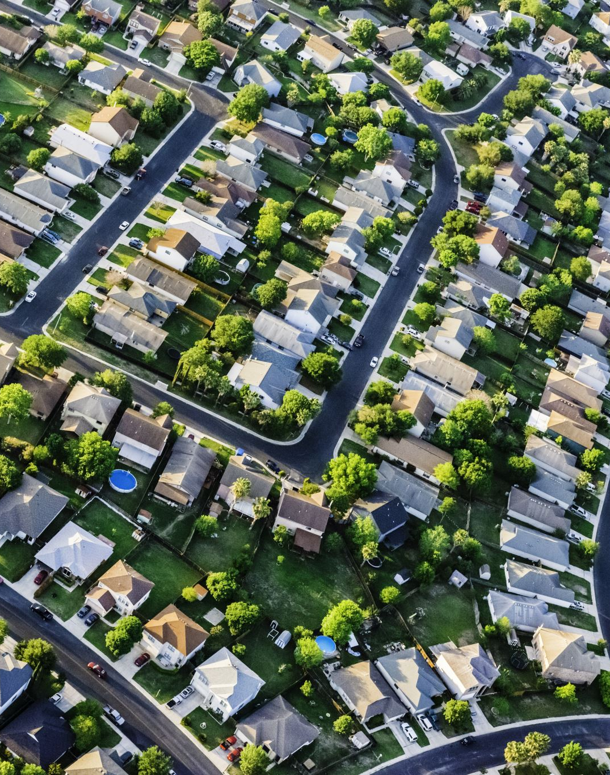
Funding Options (High Level)
There is willingness from residents to fund this project.
Level of support is noteworthy given that people were asked this without any details about the new community center.
Staff believes support increases once residents are engaged in the project.

Slide 72
Staff Recommendations Seeking Approval Tonight
Pursue a new community center?
If so, renovate/expand or new construction?
If new construction, where should it be located?
If new construction, what to do with old community center?

Slide 73
Next Steps and Timeline
At next meeting, staff will bring a contract to hire an architect to provide pre-referendum services (preliminary design of community center – elevations/renderings)
Staff will also bring a Navigate task order to serve as Construction Manager/Owner’s Rep on project
Staff will begin working to assemble the rest of the project team: bond counsel, financial adviser, communications
By December, January 2024 at the latest, Board will need to decide to place matter on April 2024 ballot

Slide 74
Next Steps and Timeline
If voters approve next April:
  Architect will proceed with finalizing design and developing construction plans
  Staff will work on the financing to obtain the necessary funds
  Optimistically, groundbreaking occurs late 2024, with construction finishing summer 2026
  If we proceed with old CC pickleball idea, that project begins in 2026, with construction wrapping in 2027

