Slide 1
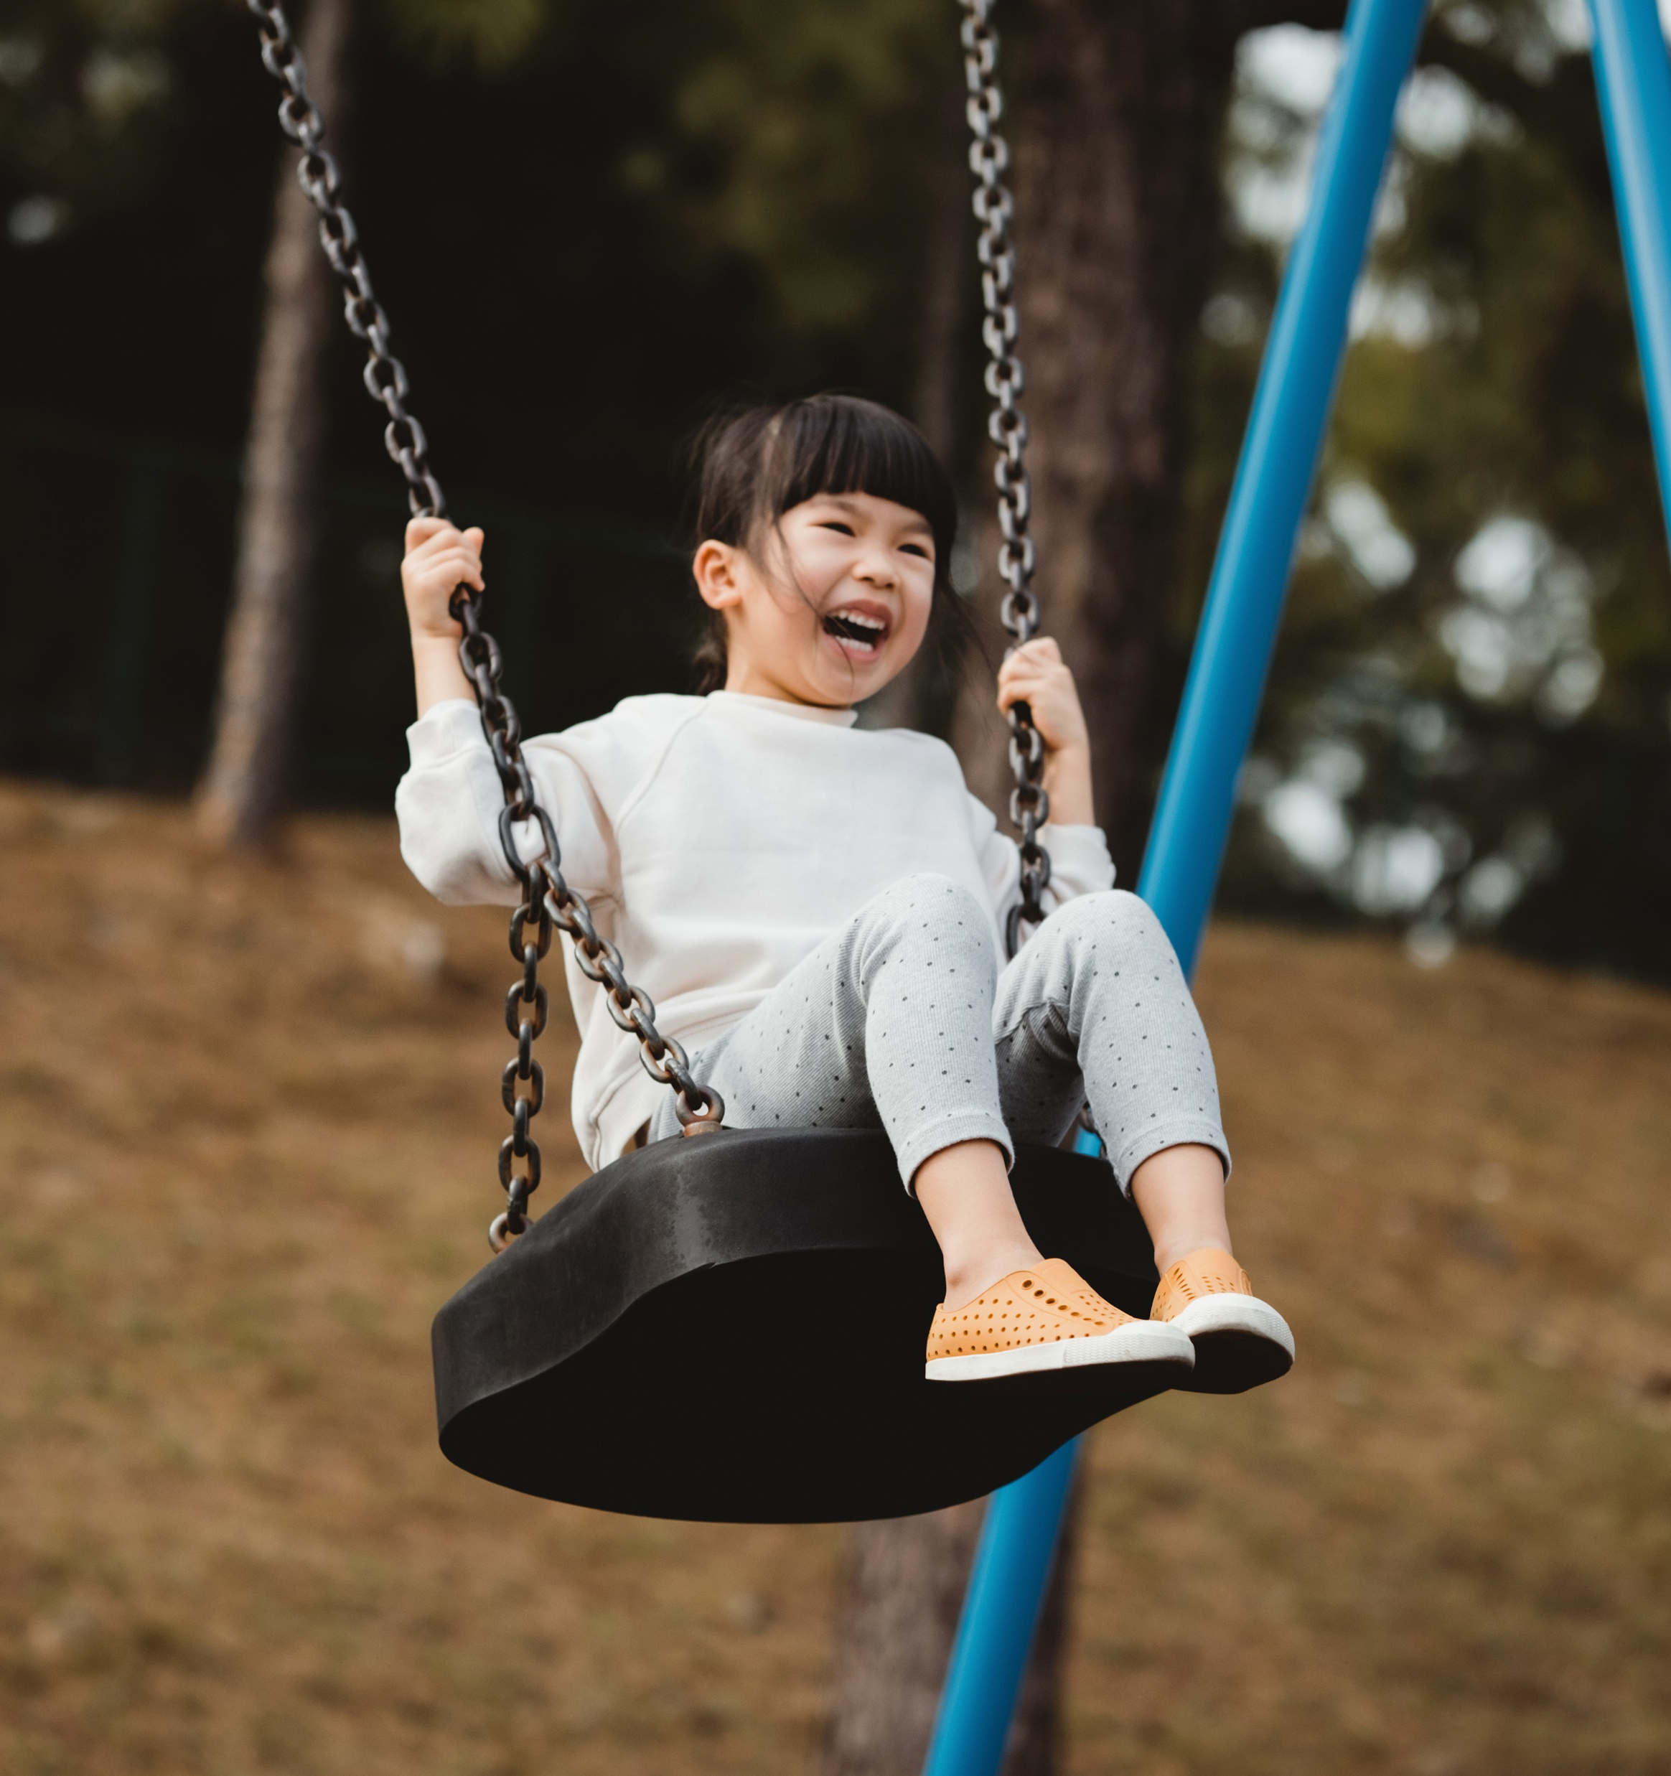

Prop A Crestwood Park Playground

Slide 2
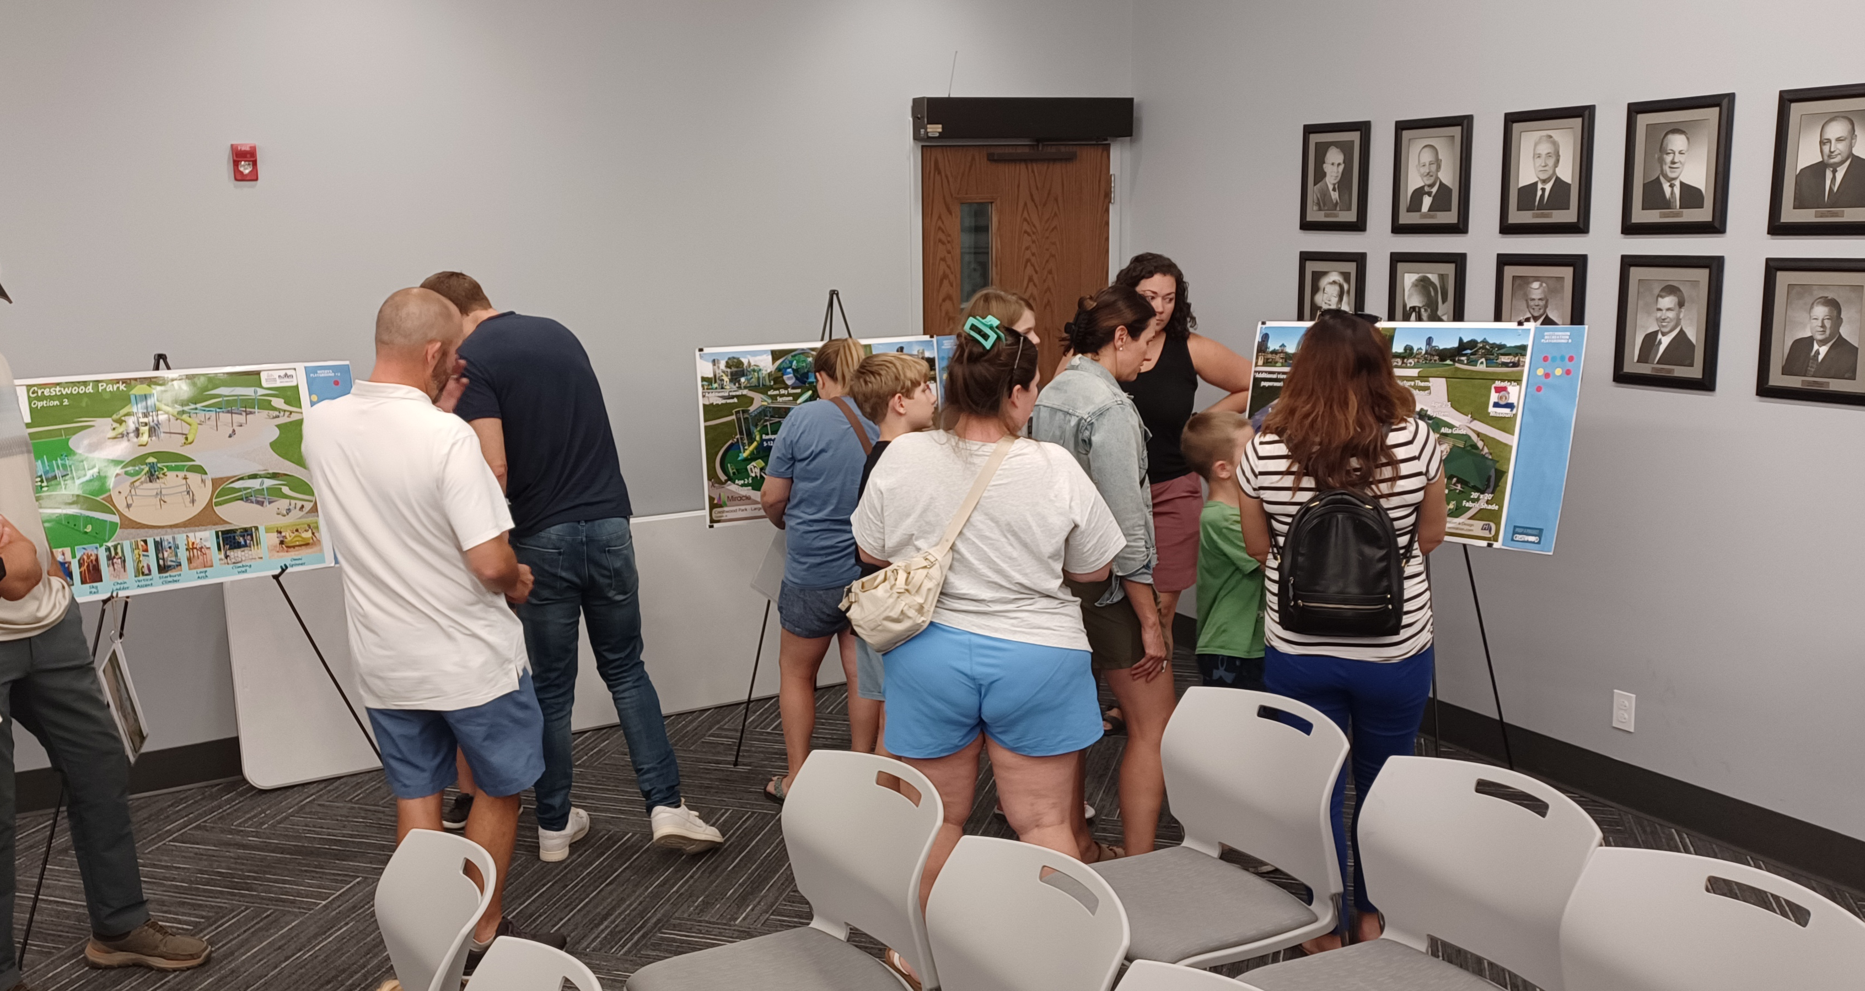
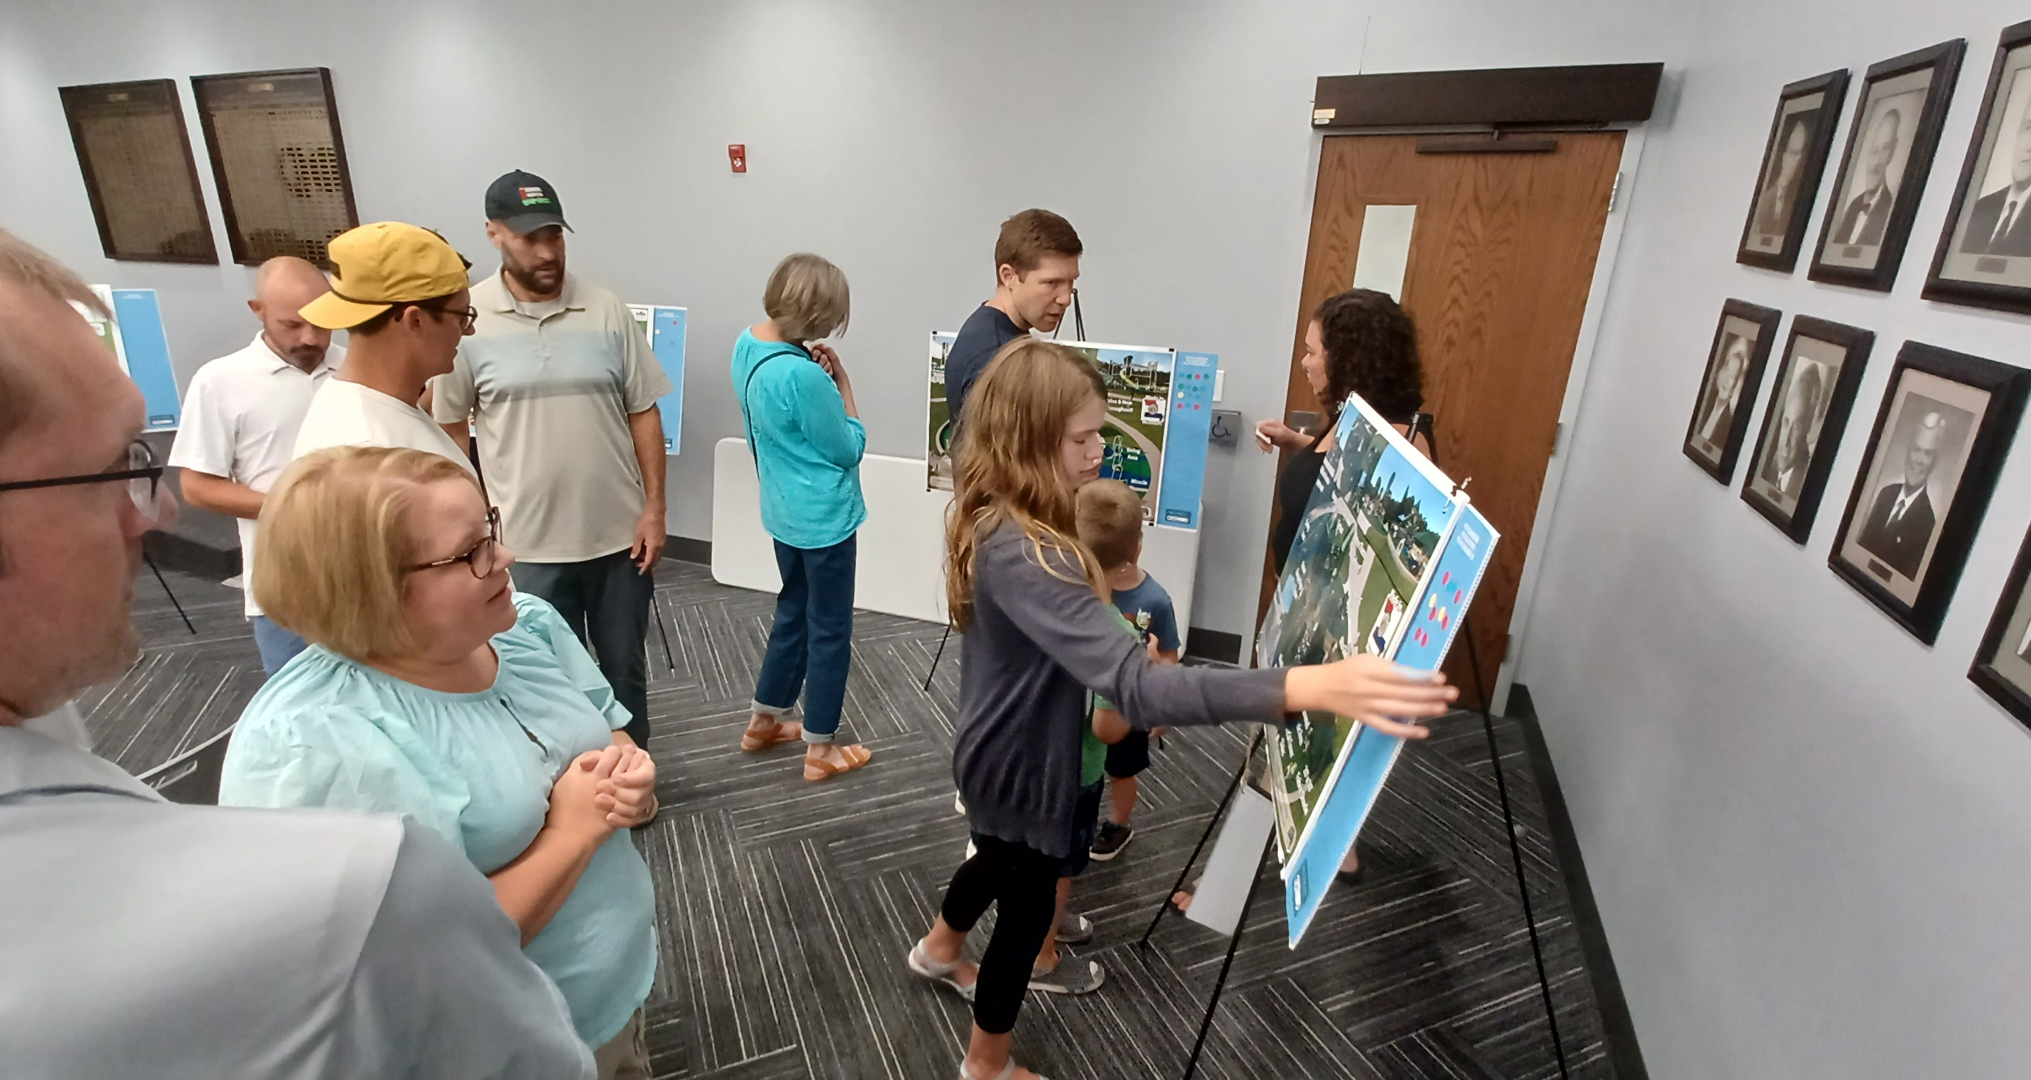
The Process June 4 - 13: Meetings with Eight Playground Vendors June 27: Open House at Crestwood Park June 27 - July 3: Online Survey July 22: Designs Due July 23 - August 1: Staff evaluated designs August 20: Park Board Meeting August 21: Voting at Community Center

Slide 3
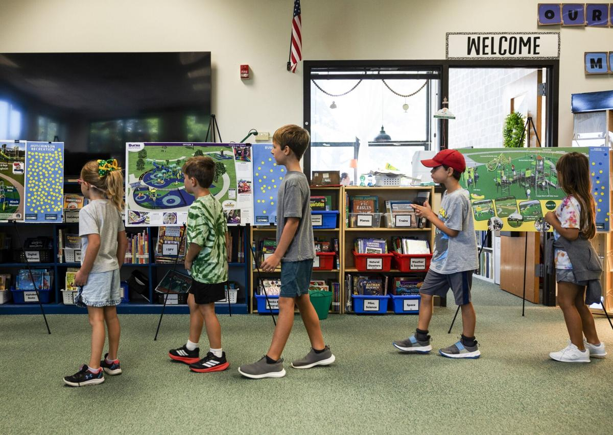
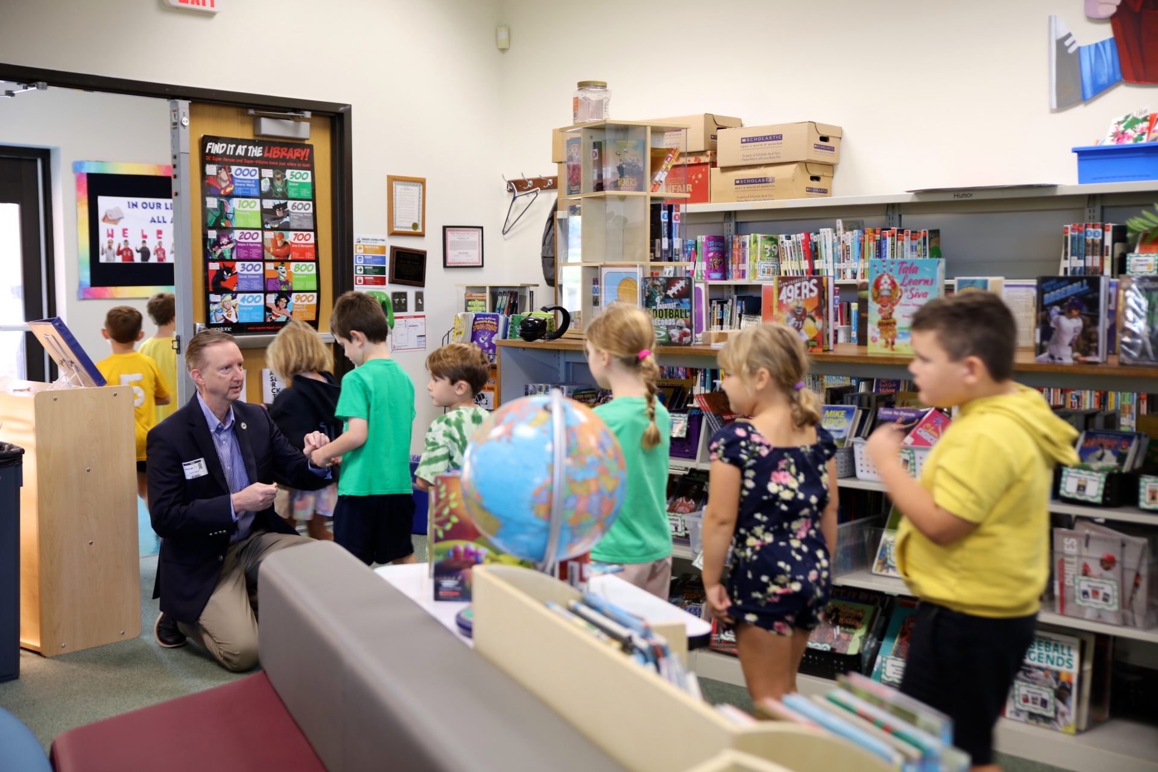
August 22/23: Long Elementary Students vote Final count Top pick 471 votes 2nd place 142 votes August 29: Met with Inclusion Coordinator September 19: Follow up meeting with Inclusion Coordinator September 20: Memo with inclusion changes given to Hutchinson for adjustments October 10: Final Designs submitted

Slide 4
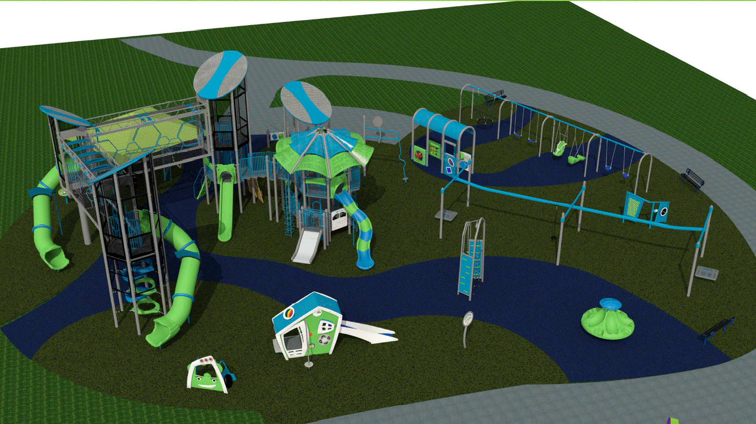

Winning Design
Hutchinson Recreation

Slide 5
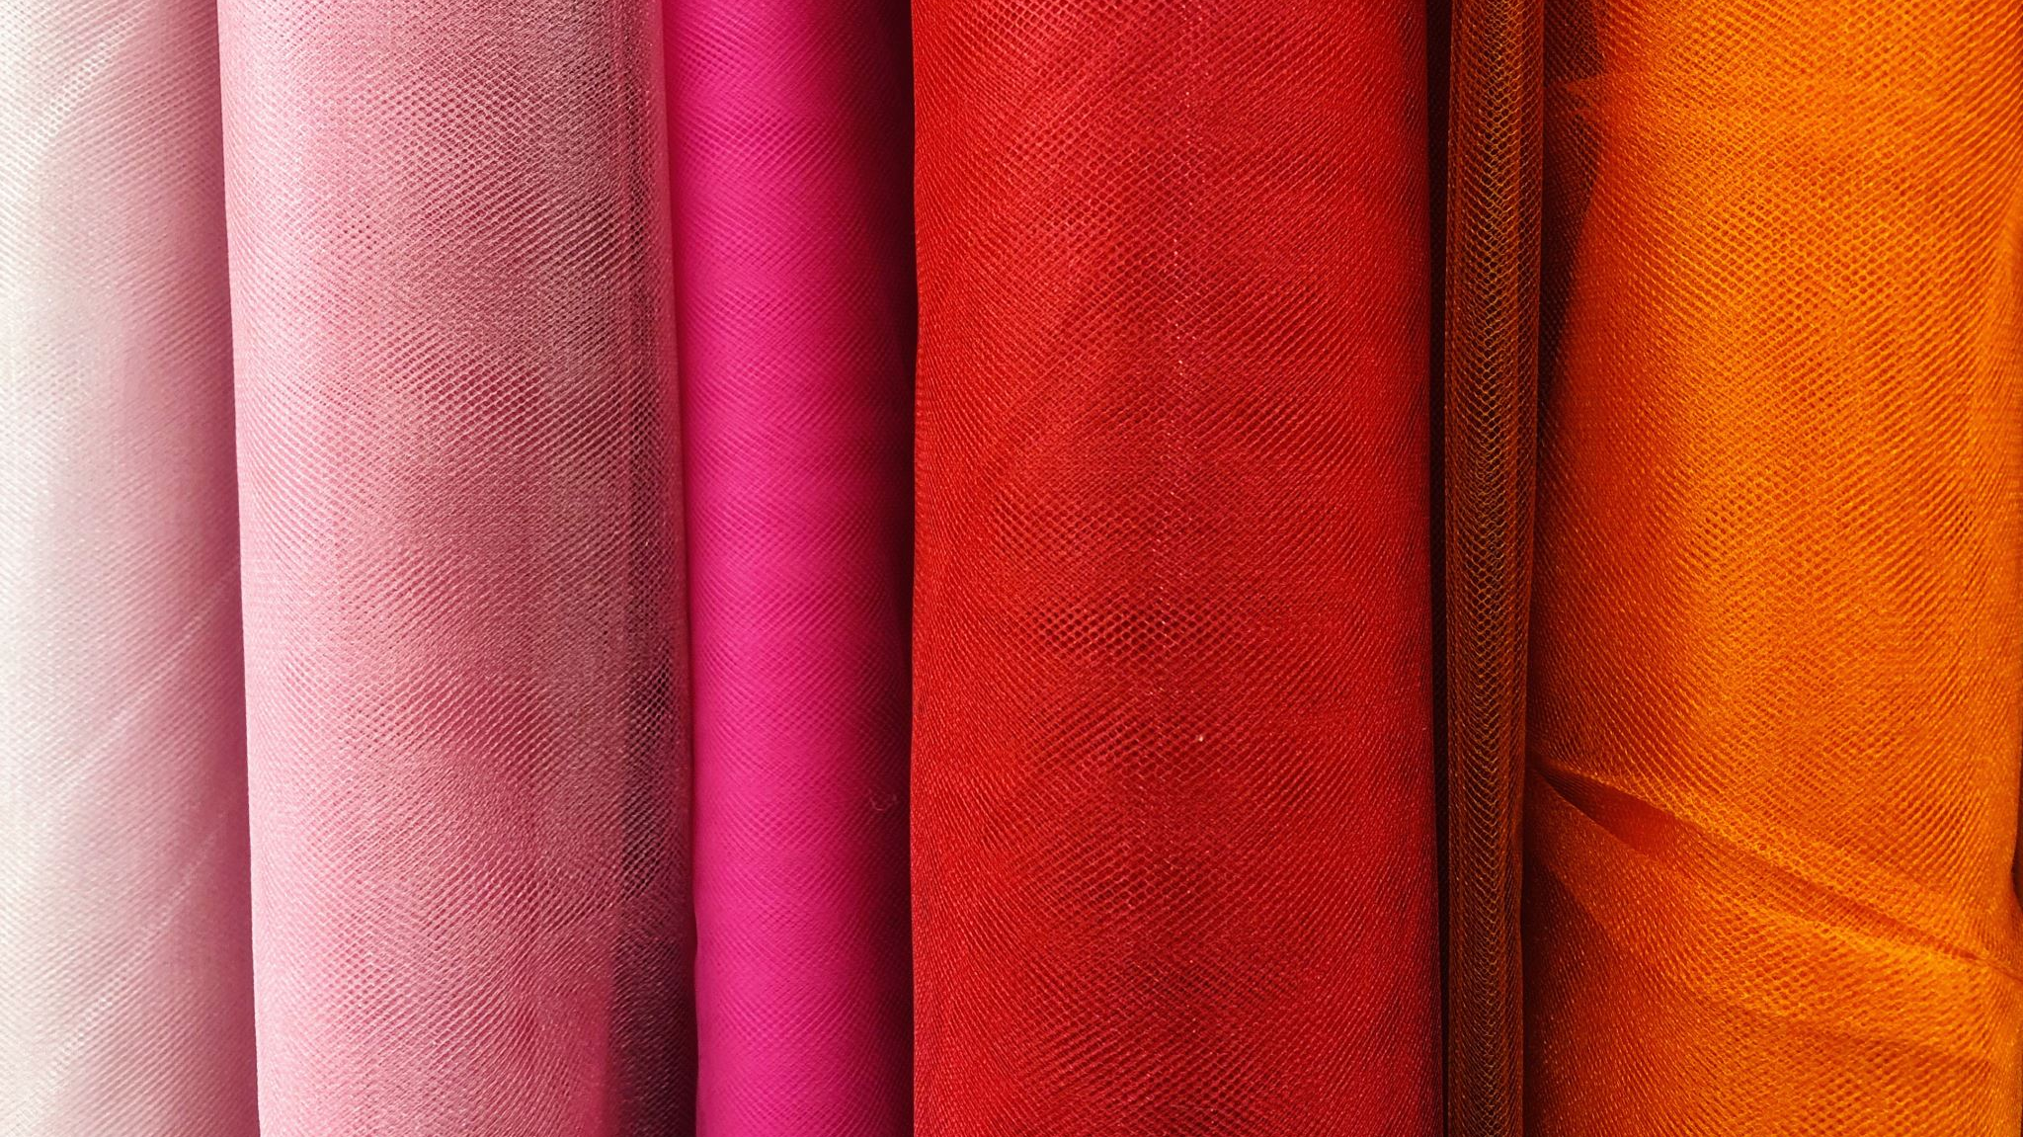
Three Color Options: No reds and yellows due to fading issues. One neutral color Color that was submitted – This is the color that was voted on. One bright color

Slide 6
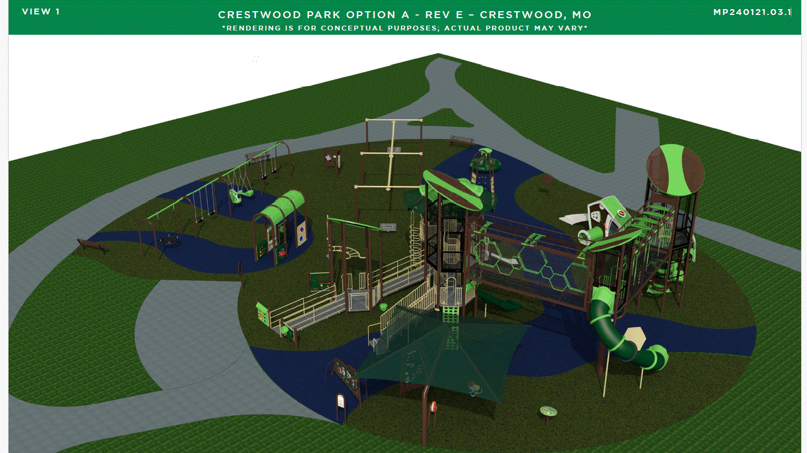

Slide 7
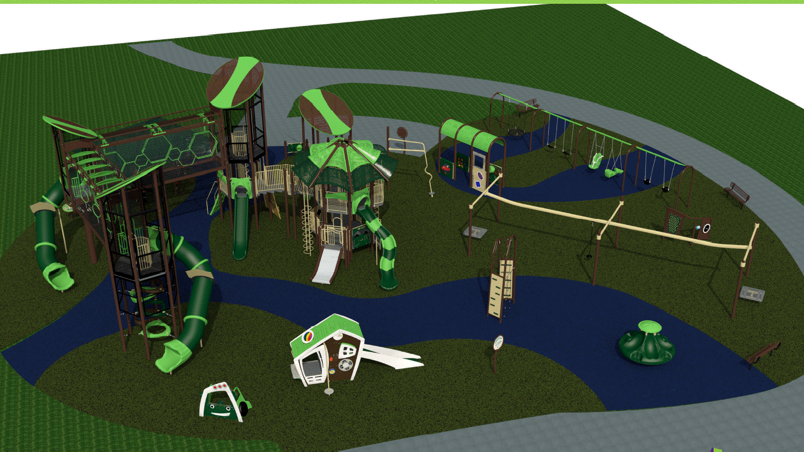

Slide 8
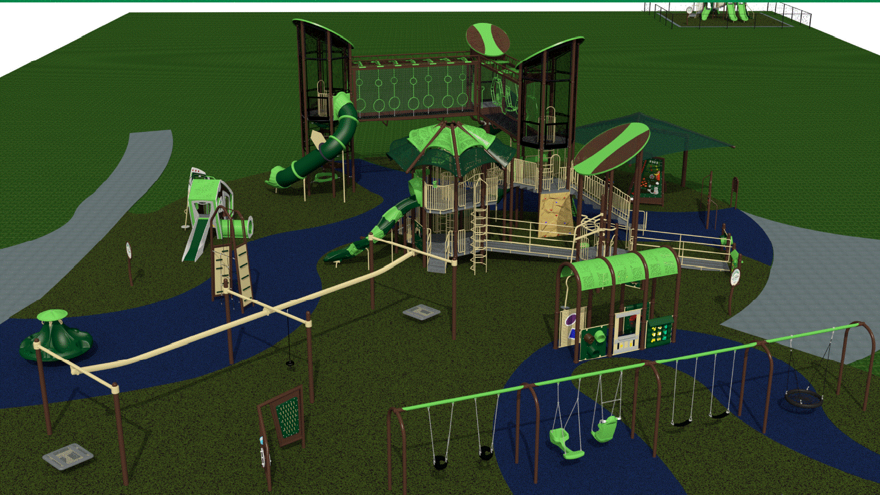

Slide 9
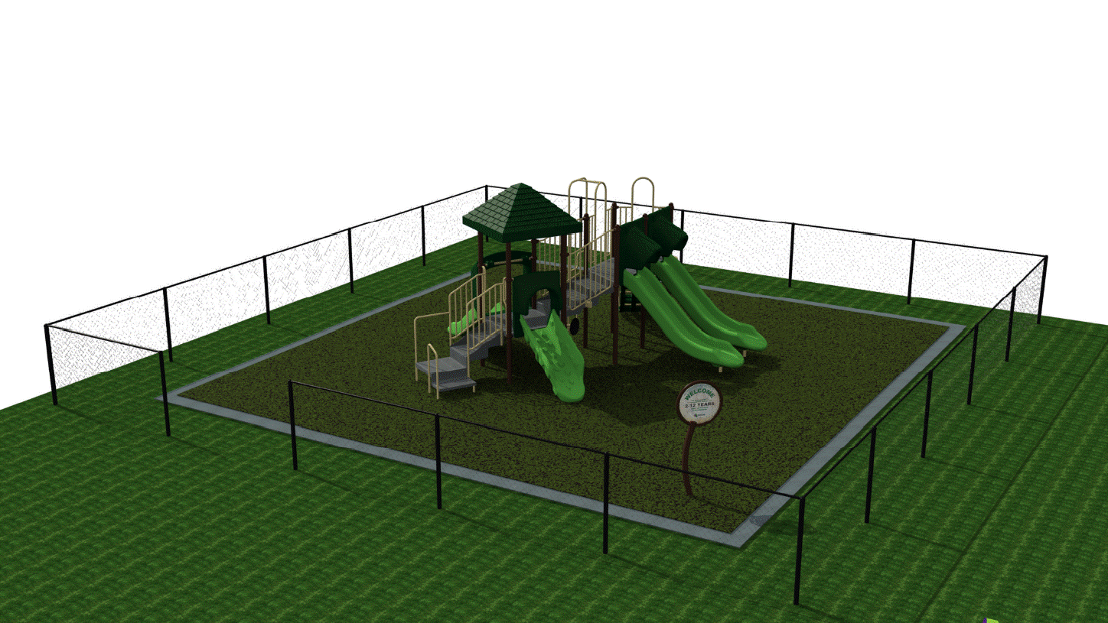

Slide 10
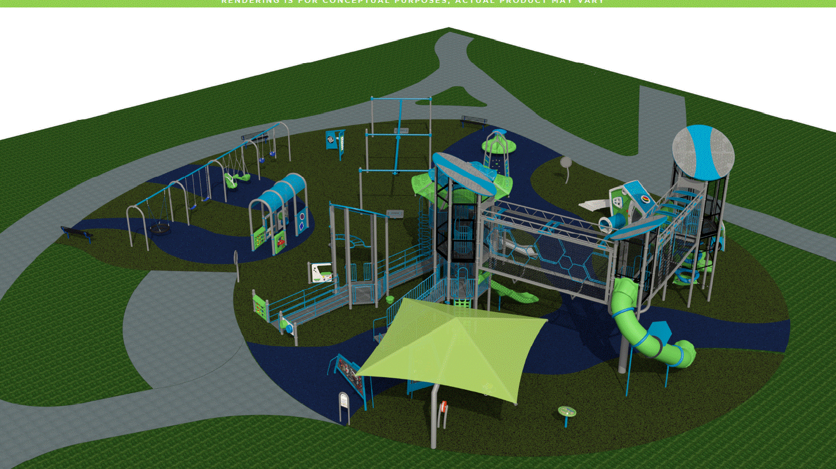

Slide 12
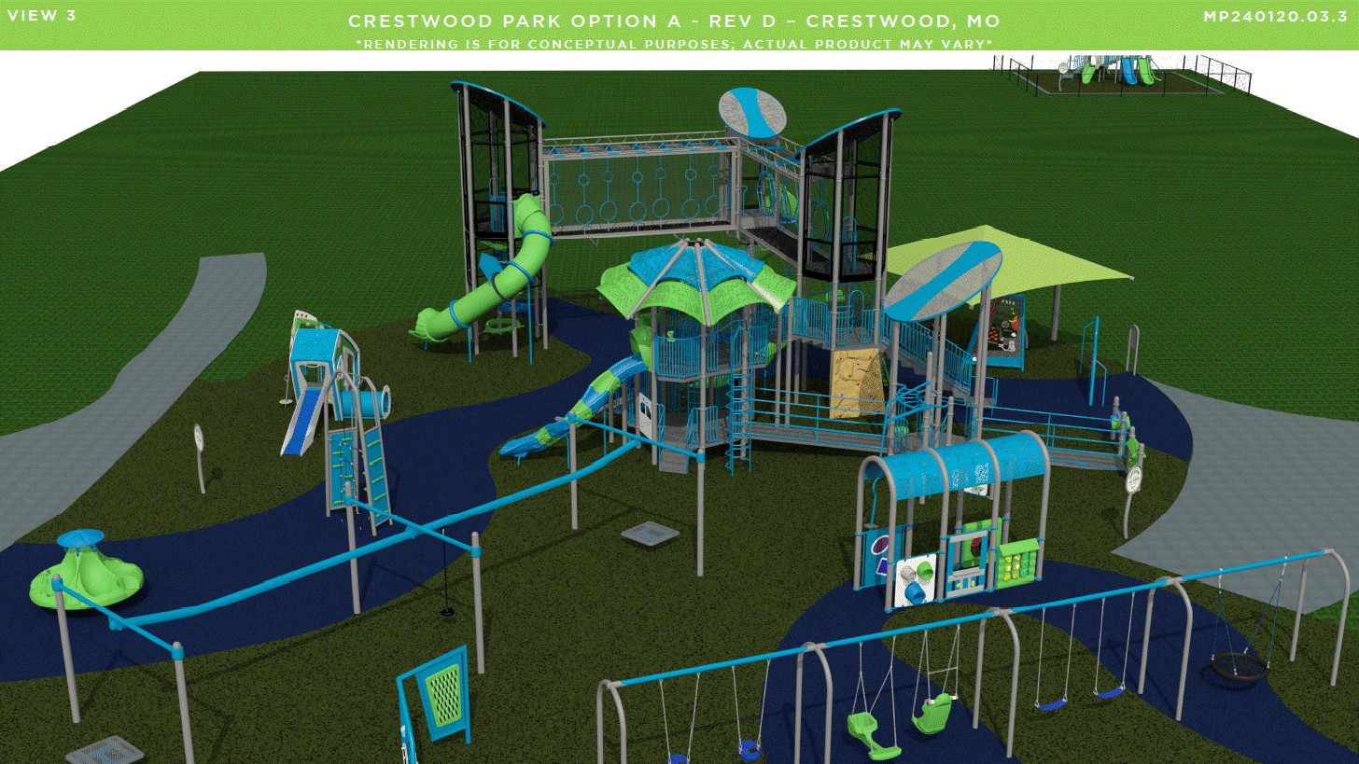

Slide 13
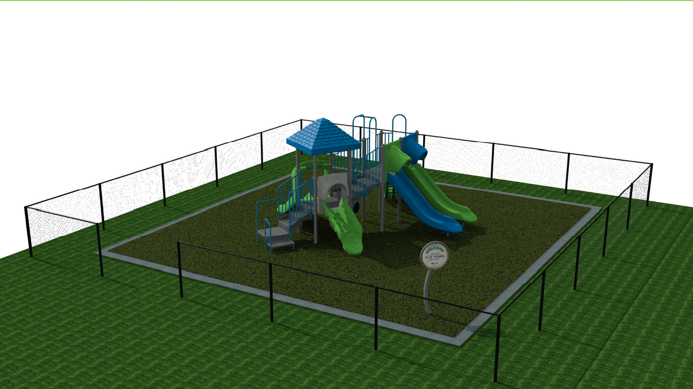

Slide 14
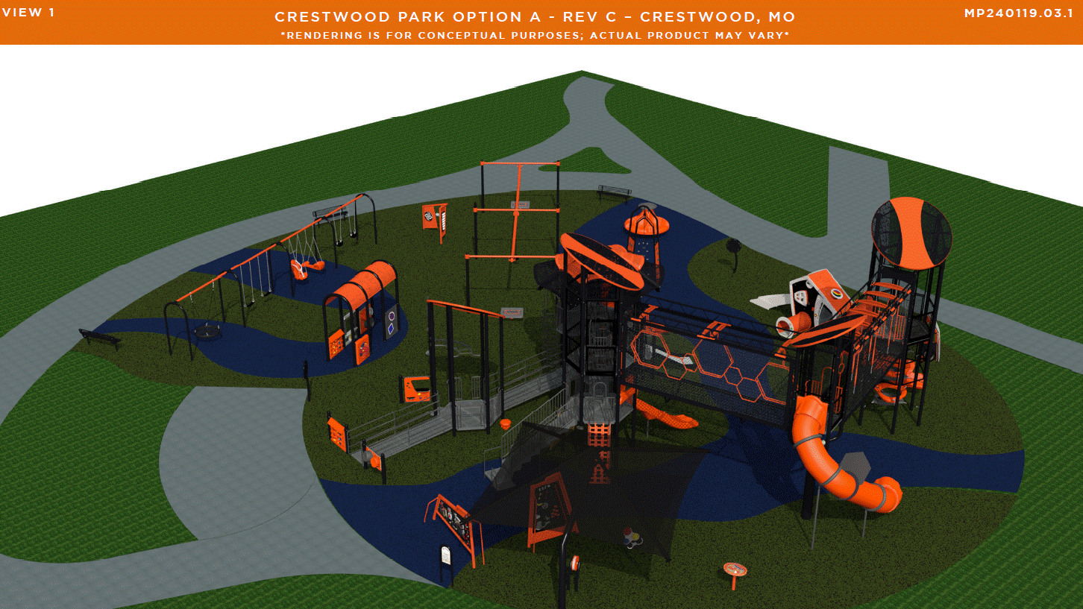

Slide 15
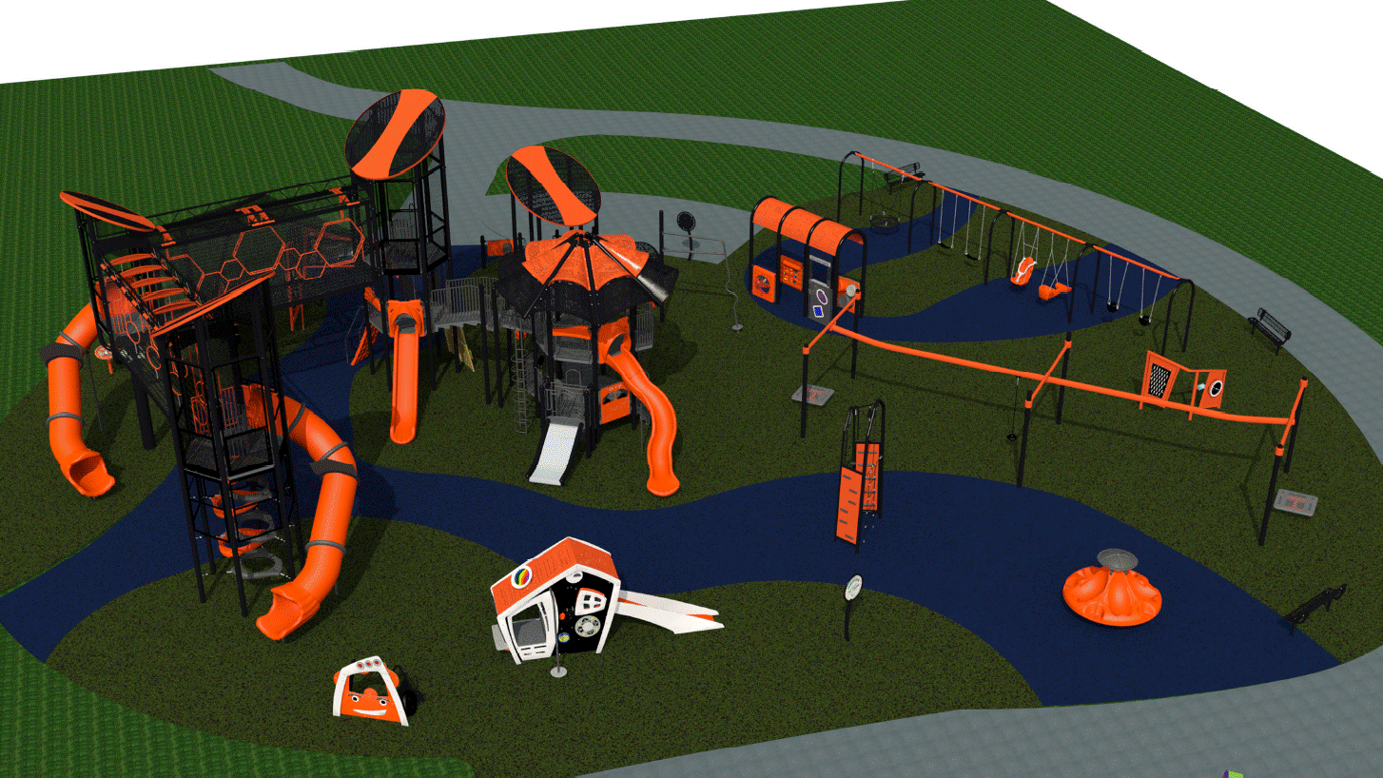

Slide 16
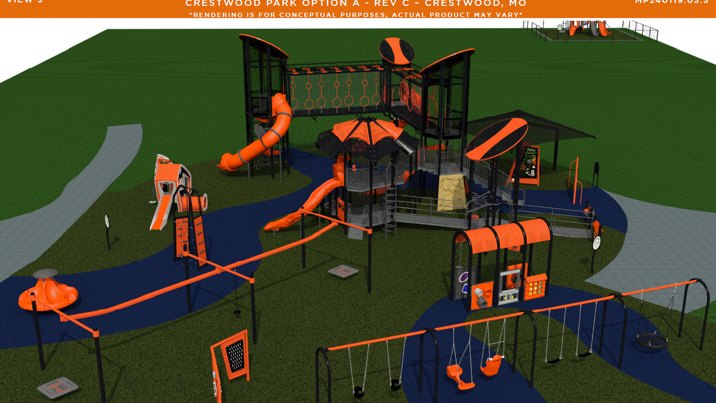

Slide 17
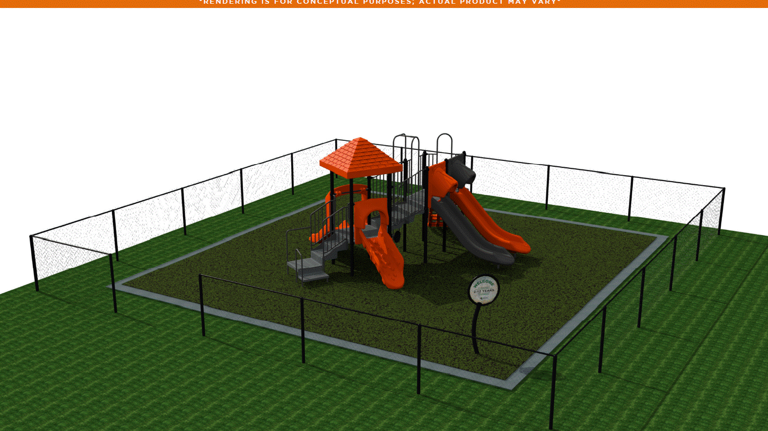

Slide 18
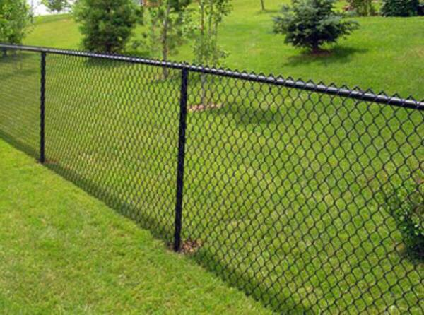
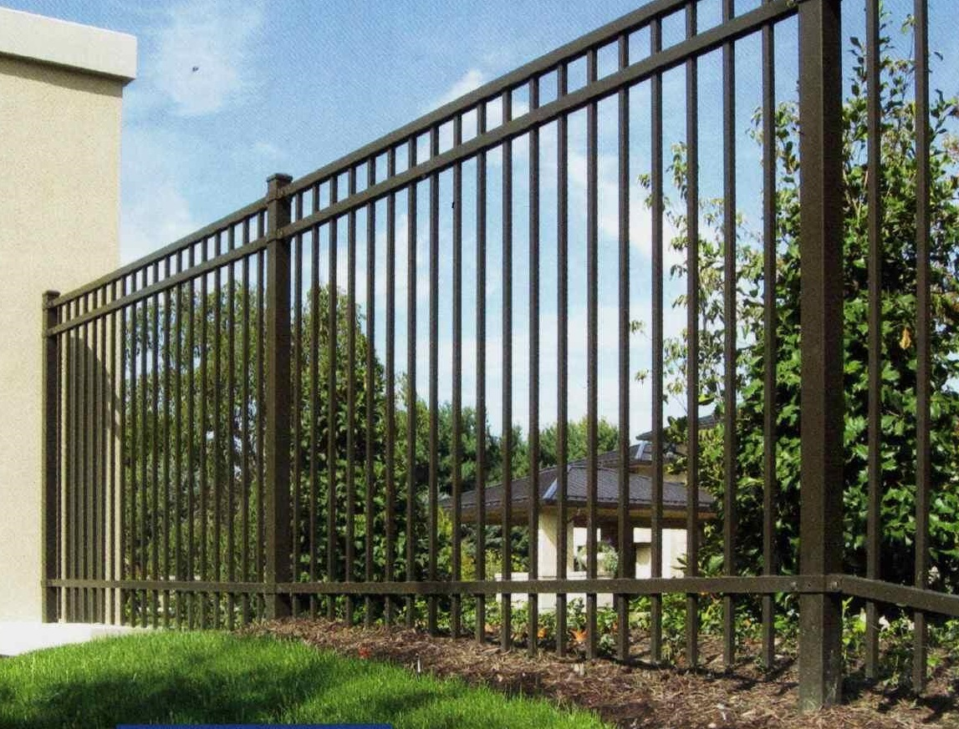
Options for Small playground
Fence – Height 48”
Option 1 – Chain link black coated fence In the original price
Option 2 – Aluminum black fence An additional $6,000
Gate for fence
Option 1 – Add a gate (either fence) An additional $1,250

Slide 19
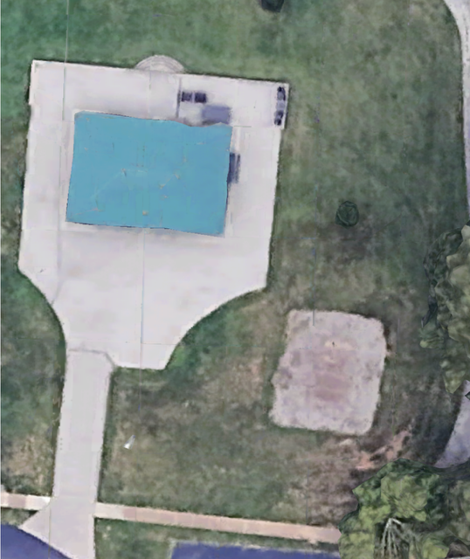
Sidewalk Options
Option 1 – Add sidewalk during installation to playground Additional $950
Option 2 – City staff will add sidewalk after project is complete
Option 3 – Do not add sidewalk

Slide 20
Next Steps:
Installation to begin - Spring 2025
Goal for opening – End of School year 2025

